Slide 1
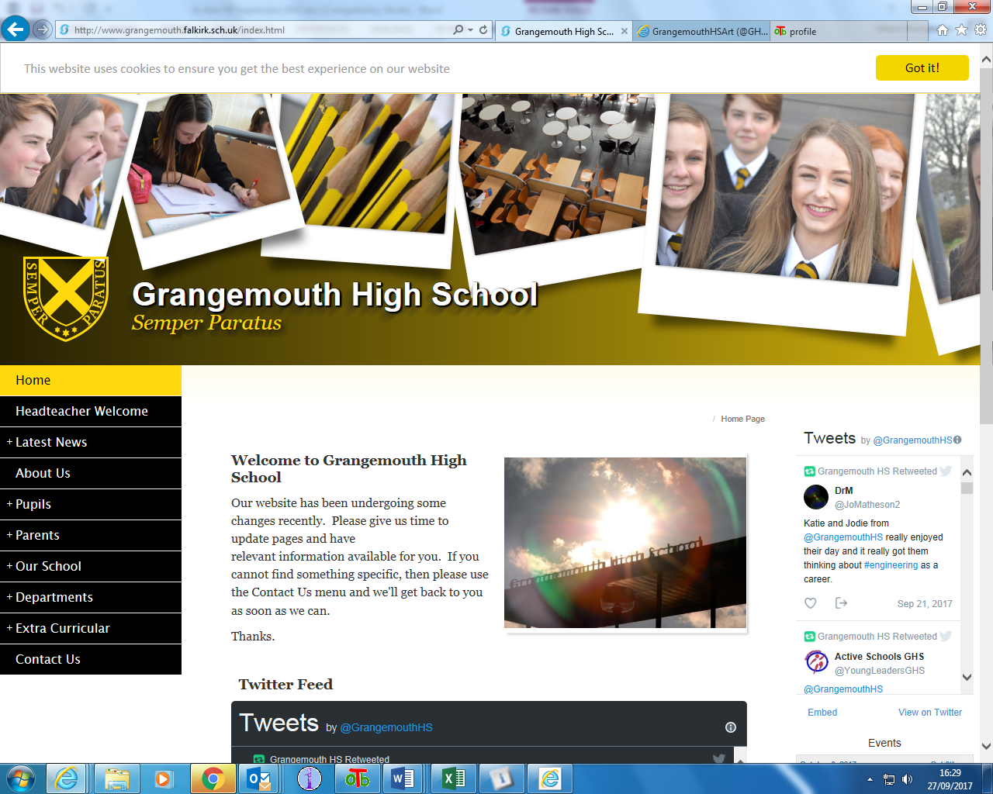
Grangemouth High School
Parent Council
Gathering and using the views of parents and carers to inform school improvement

Slide 2
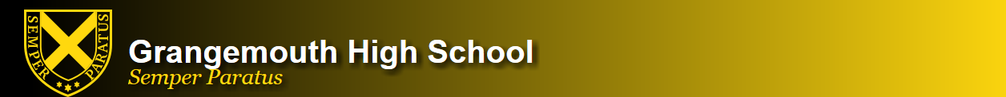
When do we gather the views of parents and carers?
Online survey (iPads) at each main Parents’ Evening – five per school session between November and February
Evaluation form after P7 Transition Evenings: February and June
Pupil & parent feedback forms with each round of pupil reports:
S1, S2 and S3: 3 reports each year group
S4, S5 and S6: 4 reports each year group
At key points when major changes are planned or evaluated: eg. changes to pupil reports

Slide 3

How is the information from parent feedback used and what does it lead to?
Parents’ Evening surveys:
Any disagree/strongly disagree responses, or any comments raising a concern, are followed up by the Pupil Support Principal Teacher for that pupil to try and resolve the matter
If the matter cannot be resolved by the Pupil Support PT, it will be passed to the House Depute and / or the Senior Leadership Team for action
Any information requested eg. SQA, Pathways, is collated and posted out to parents
S1-3 and S4-6 survey data is collated and discussed at SLT to check for common themes in any matters raised and to inform improvement priorities for next session

Slide 4
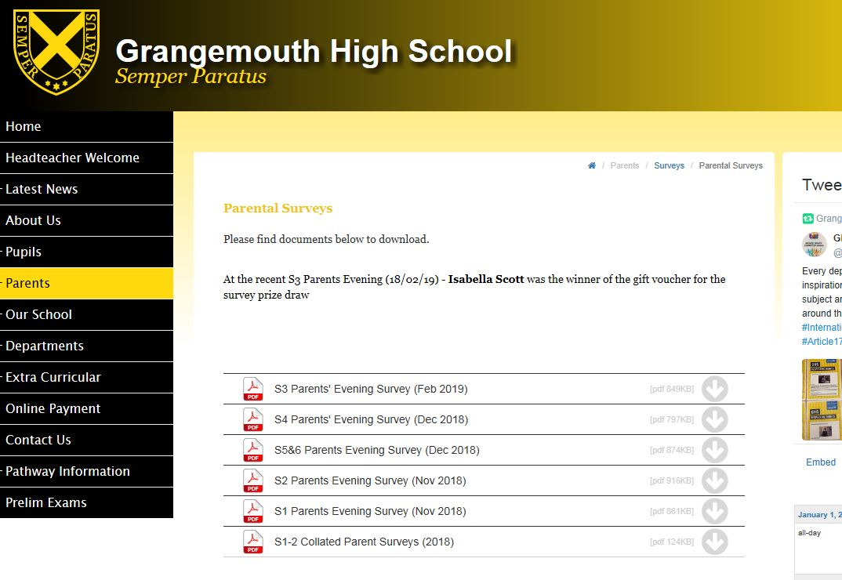
How is the information from parent feedback used and what does it lead to?
Survey results are anonymised and posted on the website.
Tweet/Group text sent to advise parents and carers and survey data shared with all staff in school
GDPR: Survey data is destroyed after 12 months and removed from the school website

Slide 5
Improvements made as a result of parent feedback
Parent Evening surveys are consistently very positive
Concerns raised are always small in number and always followed up
Information sent to each year group eg. with reports etc, is often influenced by responses to parent questionnaires where more information is requested
SLT monitor and discuss each set of survey results to check for any patterns or trends in concerns that would require wider improvement actions
Surveys are also collated into BGE (S1-3) and Senior Phase (S4-6) to allow us to evaluate a larger set of responses

Slide 6
Feedback from parents and carers on reports
Returned forms are passed to House Depute so that any questions or concerns can be followed up eg. Principal Teacher of the subject asked to call parent to clarify report
Information is collated for each year group after the last round of reports and discussed by SLT
Any common themes/ priorities are shared with the relevant school improvement group
Potential improvements are discussed, staff consulted and actioned if appropriate

Slide 7
Improvements made to pupil reports as a result of parent feedback
Employability & Social Skills
The statements used by staff for these covered on two aspects of each skill which some parents found confusing
EG: “Organisation” statement covered time keeping and coming prepared for classes
Action
Statements were simplified to focus on one key aspect to make the statement clearer and avoid confusion
EG: “Organisation” now focuses on coming prepared for classes

Slide 8
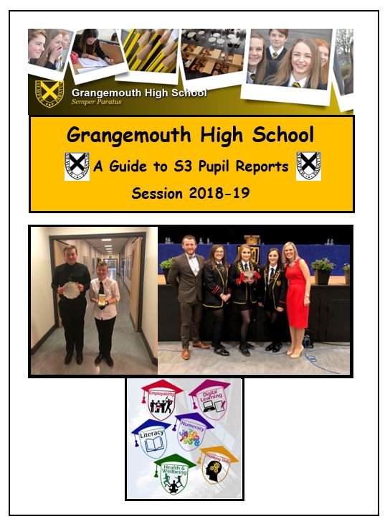
Improvements made to pupil reports as a result of parent feedback
Some parents indicated the levels in BGE reports are not easy to understand
Actions:
Levels in BGE are very broad – now broken down using “bronze/silver/gold” statements to explain progress in more detail
Parent Information Leaflet updated to include table and examples of pupil pathways to show how Levels in S1-3 progress into S4-6 and qualifications

