Slide 1
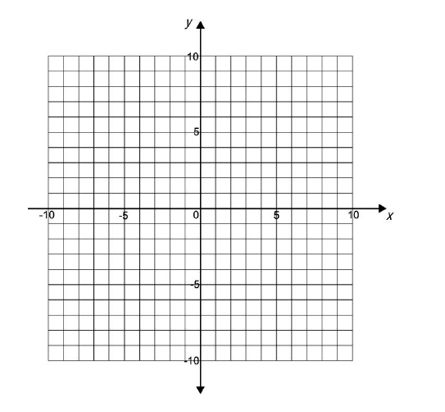
National 4 Relationships Part One Practice Assessment (All)
Complete the table below for y = 4x - 5
x 1 2 3
Line CD is shown on the grid below
Write done the equation of the line CD
C
D

Slide 2

Solve the following equation:
3y - 4 = - 22
Change the subject of the formula to a
b = 7a + 8
Triangle ABC is a right-angled triangle as shown in the diagram below
BC is 28 metres long and AB is 15 metres long.
Calculate the length of AC in metres
A
C
15 m
28 m
B
$$\frac{3}{2}$$
7. On the diagram below, drawn an enlargement of the given shape using a scale factor of

Slide 3
National 4 Relationships Practice Assessment (3)
1.
Calculate the size of angle ABC. All working must be shown.
B
L
E
K
120°
G
D
60°
N
F
M
C
A
L
CD is a diameter of a circle centre O.
L is a point on the circumference of the circle
Calculate the size of angle LKM
K
54°
M
3. Calculate the length of the side x in the following right-angled triangle below
x
29°
28 m

Slide 4
A ramp 75m long slopes at an angle of x° from Level 1 to Level 2.
The height between levels is 8 metres.
(a) Calculate x°
Level 2
75 m
8 m
Level 1
x°
(b) For safety reasons x should be below 6°. Can the angle of the ramp be considered safe ?
5. A class of students sat a Geography and a History test. Here are the students marks
Geography History
Tom 85 70
Bob 50 60
Cecil 35 35
Bertie 70 75
Selma 80 85
Louise 75 25
Bruce 95 90
Draw a scattergraph on the grid provided
Draw a line of best fit
Walter scored 70 marks in his geography test. Use your line to estimate the mark that he would
have got in his history test
Oliver scored 55 marks in his geography test but was absent for his history test. His teacher
estimated her mark to be 50 for his history test.
Is this a reasonable estimate ?

Slide 5
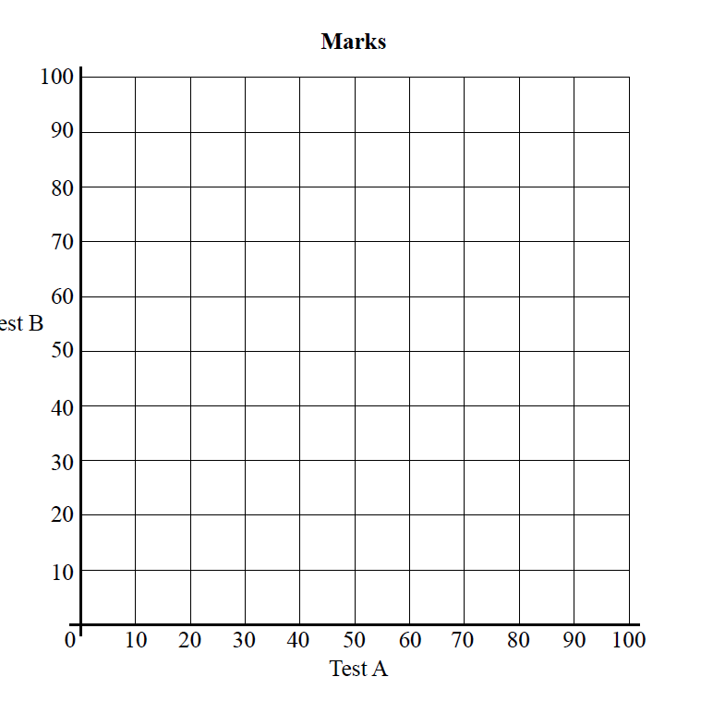
History
mark
Geography mark

