Slide 1
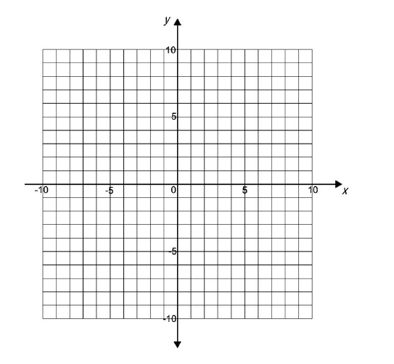
National 4 Relationships Part One Practice Assessment (All)
Complete the table below for y = 2x - 3
x 1 2 3
Line CD is shown on the grid below
Write done the equation of the line CD
C
D

Slide 2

Solve the following equation:
5y + 6 = -9
Change the subject of the formula to a
b = 3a + 5
Triangle ABC is a right-angled triangle as shown in the diagram below
BC is 10 metres long and AB is 5 metres long.
Calculate the length of AC in metres
A
C
5 m
10 m
B
$$\frac{3}{2}$$
7. On the diagram below, drawn an enlargement of the given shape using a scale factor of

Slide 3
National 4 Relationships Practice Assessment (3)
In the diagram below lines DE and FG are parallel
Lines AB and BC intersect DE and FG at the points P, Q, R and S as shown.
Angle DKM is 56° and angle LNG is 119°
Calculate the size of angle ABC. All working must be shown.
B
L
E
K
119°
G
D
56°
N
F
M
C
A
L
CD is a diameter of a circle centre O.
L is a point on the circumference of the circle
Angle KML is 38° Calculate the size of angle LKM
K
49°
M
3. Calculate the length of the side x in the following right-angled triangle below
x
37°
34 m

Slide 4
A ramp 120m long slopes at an angle of x° from Level 1 to Level 2.
The height between levels is 12 metres.
(a) Calculate x°
Level 2
90 m
10 m
Level 1
x°
(b) For safety reasons x should be below 6°. Can the angle of the ramp be considered safe ?
5. A class of students sat a Geography and a History test. Here are the students marks
Geography History
Tom 84 75
Bob 55 53
Cecil 38 44
Bertie 65 72
Selma 78 85
Louise 66 89
Bruce 57 68
Draw a scattergraph on the grid provided
Draw a line of best fit
Walter scored 60 marks in his geography test. Use your line to estimate the mark that he would
have got in his history test
Oliver scored 75 marks in his geography test but was absent for his history test. His teacher
estimated her mark to be 50 for his history test.
Is this a reasonable estimate ?

Slide 5
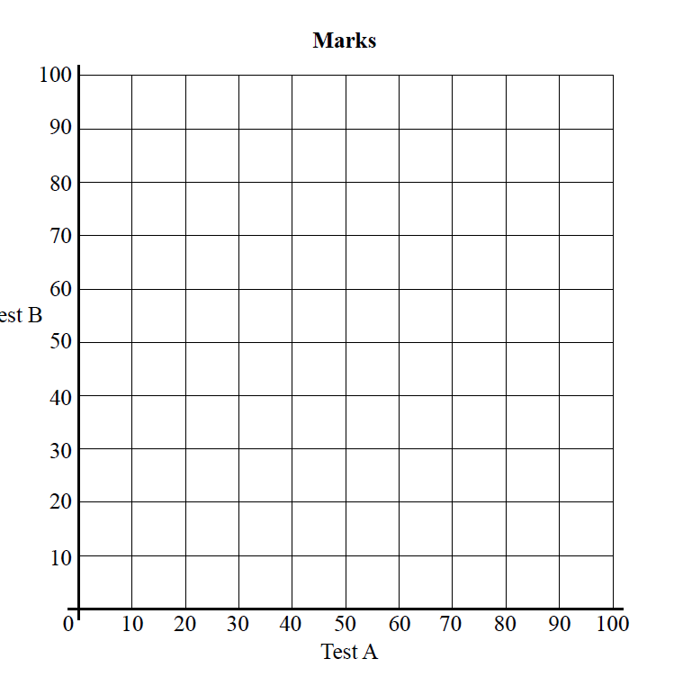
History
mark
Geography mark

