Slide 1

Important
As you may not have your jotter, work can be completed on paper or digitally. For example, on Microsoft Word. ​
If possible, you can share your work with your teacher by uploading to Teams via the Assignment tab. ​​
Submitted work will receive feedback but please note this will not happen instantly and feedback may not come from your class teacher but another member of the Humanities Faculty.​
Stay safe everyone!

Slide 2
Important
Scan a document on your iPhone​
Open a note or create a new note.​
Tap , then tap Scan Documents.​
Place your document in view of the camera on your device.​
If your device is in Auto mode, your document will be automatically scanned. If you need to manually capture a scan, tap or one of the Volume buttons.​
Drag the corners to adjust the scan to fit the page, then tap Keep Scan.​
You can add additional scans to the document or tap Save when you're done.

Slide 3
Important
When uploading your work to Teams please follow the instructions below.​
1. Find and click on the Assignment tab at the top of the Teams’ screen.​
2. Click on the Assignment you want to upload your work to.​
3. Attach your work (photo/word doc/PowerPoint) using the upload document section.​
This means that your work is saved next to your name and can be clearly seen as being handed in by your teachers. **You should not be posting your work on the chat**​
If it comes up with an error message then try again later on in the day. If it still comes up with an error message then please post a message on the posts tab.​
***If you are taking a picture of your work, please only take portrait pictures (straight up and down).

Slide 4

Starter – crack the code
These slides have voice overs to help. If you click play PowerPoint you will hear me. How exciting.
I do ramble a lot though.
Open your jotter.
Crack this code to work out todays topic?
If a=1 b=2 and c=3 all the way to z= 26 then what does the following phrase say.
20, 8, 5
20, 18, 9, 1, 14, 7, 21, 12, 1, 18
20, 18, 1, 4, 5

Slide 5

Will it stick?
Will it stick?
Today we are going to be learning about the triangular trade.
To be successful today you will be able to describe the process known as the triangular trade.

Slide 6
Slavery in History
Slaves were so important to societies of the past because they were used to carry out everyday tasks, such as farming and housework. This allowed people like the Spartans the time to perfect their fighting skills and allowed the Romans the time to invade other countries.

Slide 7
Why did people become slaves?
Copy this
One reason that people became slaves was to pay off debts that they owed or were owed by their family. Another reason is that they may have been captured by foreign countries and sold as slaves.

Slide 8
The African Slave Trade
The Atlantic Slave Trade took place between 1540 and 1850.
The number of slaves that were involved in the Atlantic Slave Trade was huge.
15 million Africans were captured in Africa and shipped across the Atlantic with only 11 million surviving the journey.

Slide 9
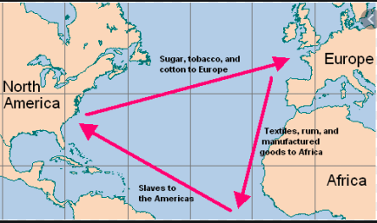
The Triangular Trade.
The ships that carried slaves from Africa to America moved along a route called the Triangular Trade.
This route was made up of three stages that when drawn on a map make a triangle.

Slide 10
Task 1
Use the information on the following slide to answer these questions about each stage of the Triangular Trade.
Remember to write in full sentences.
You should have 6 answers. 2 for each stage.
Where did each stage start and stop? (e.g. Stage one started in _______ and finished in _______)
What was carried on board the ship on each stage of the ship? (e.g. On stage one the ship carried _______)

Slide 11
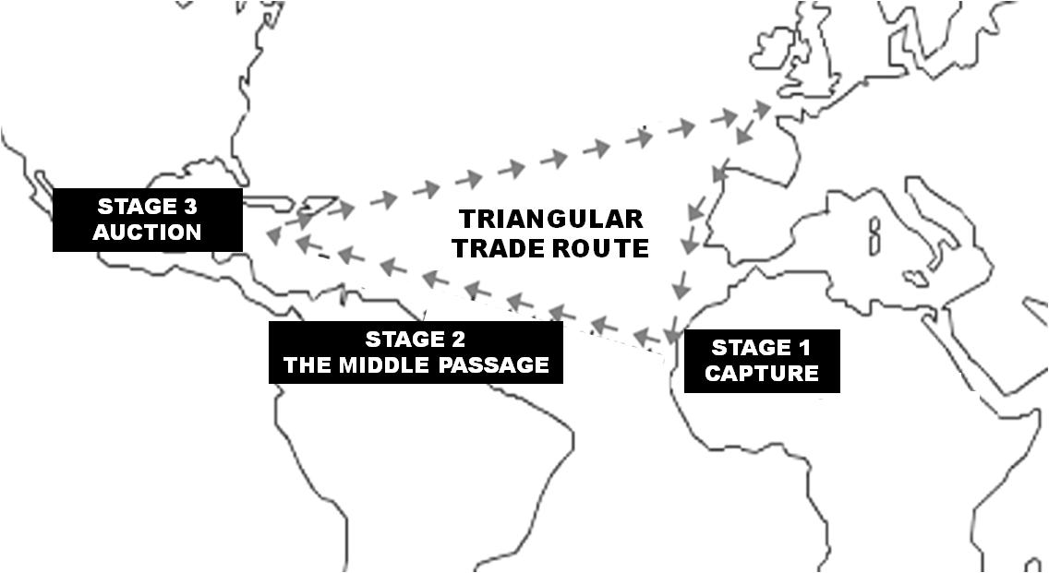
Slaves were sold at auction . The ships would then be loaded with slave grown raw materials, such as sugar, tobacco, coffee and cotton to be taken back to Britain for sale
Slave ships travelled from Britain to the west coast of Africa and the crew traded manufactured goods, such as pots, pans, cloth, guns and alcohol with Africans in exchange for African slaves.
Slaves were loaded on to ships and taken across the Atlantic Ocean to the Americas. Many slaves died of disease during this stage with 4 million of the 15 million slaves captured never making it to auction.

Slide 12
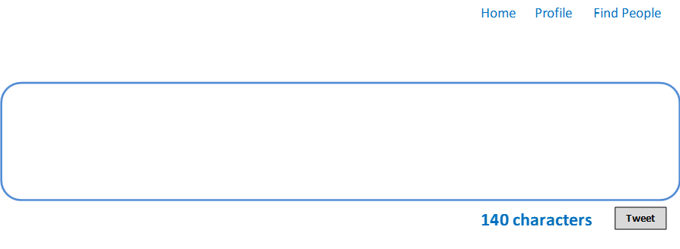

Task 2
Imagine you are a captain on a ship traveling the triangular trade. You must write a tweet for each stage of your journey. Think about what is on board your ship, what you might see, smell, feel. You should have three separate tweets.

Slide 13

You have finished another weeks history work.

