Slide 1

Important
As you may not have your jotter, work can be completed on paper or digitally. For example, on Microsoft Word. ​
If possible, you can share your work with your teacher by uploading to Teams via the Assignment tab. ​​
Submitted work will receive feedback but please note this will not happen instantly and feedback may not come from your class teacher but another member of the Humanities Faculty.​
Stay safe everyone!

Slide 2
Important
Scan a document on your iPhone​
Open a note or create a new note.​
Tap , then tap Scan Documents.​
Place your document in view of the camera on your device.​
If your device is in Auto mode, your document will be automatically scanned. If you need to manually capture a scan, tap or one of the Volume buttons.​
Drag the corners to adjust the scan to fit the page, then tap Keep Scan.​
You can add additional scans to the document or tap Save when you're done.

Slide 3
Important
When uploading your work to Teams please follow the instructions below.​
1. Find and click on the Assignment tab at the top of the Teams’ screen.​
2. Click on the Assignment you want to upload your work to.​
3. Attach your work (photo/word doc/PowerPoint) using the upload document section.​
This means that your work is saved next to your name and can be clearly seen as being handed in by your teachers. **You should not be posting your work on the chat**​
If it comes up with an error message then try again later on in the day. If it still comes up with an error message then please post a message on the posts tab.​
***If you are taking a picture of your work, please only take portrait pictures (straight up and down).

Slide 4
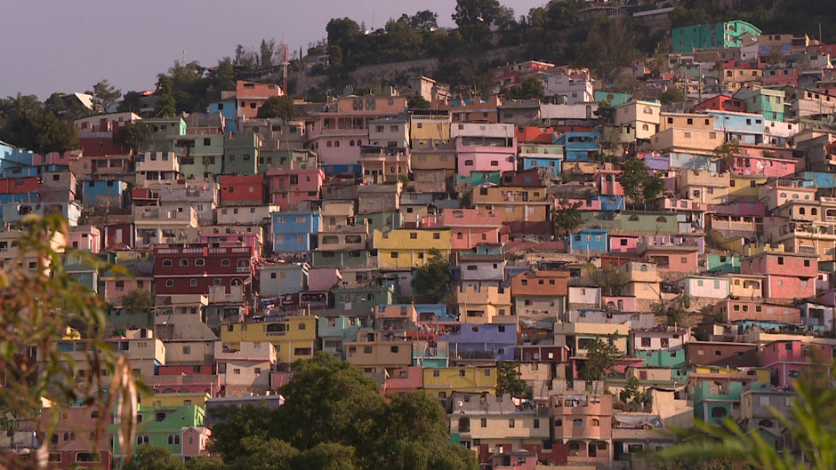

Cholera in Haiti
These slides have voice overs to help. If you click play PowerPoint you will hear me. How exciting.
I do ramble a lot though.

Slide 5
Learning Intentions & Success Criteria
Learning Intentions: This week you will be learning about the cholera outbreak which hit Haiti after the earthquake.
Success Criteria: This week you will be successful if you can use the information in the slides to answer questions about the cholera outbreak.

Slide 6
Cholera in Haiti
In 2010 the people of Haiti who survived the earthquake now had another problem they needed to face.
Due to the poor drinking water left on the island after the earthquake, cholera started to spread throughout the island.

Slide 7
What is cholera?
Cholera is an infection in the small intestine. It is caused by the bacterium Vibrio cholerae.
In recent years, cholera has afflicted at least 770,000 Haitians and claimed over 9,200 lives. The Haitian epidemic alone resulted in an 85 percent increase in the number of cholera cases worldwide.

Slide 8
What are the symptoms of cholera?
Task 1: Draw a stick man and label the symptoms of cholera on the body.
The first symptoms are stomach pains, which quickly turn into diarrhoea that becomes rapidly worse, eventually producing what is known as ‘rice water’ – pale, watery faeces, which pours out of the body.
Patients can lose up to 10 litres of fluid in a single day and, if left untreated, the dehydration caused by the diarrhoea can kill a person within 24 hours

Slide 9
Task 2
Use the information on the following slides to answer the questions below.
1. How is cholera spread?
2. How many people have died from cholera since the 2010 earthquake?
3. Why have so many Haitian people had cholera since 2010?
4. What is the treatment for cholera?
5. What aid has The Red Cross given to Haiti to help stop the spread of cholera?

Slide 10
How is cholera Spread?
The bacteria which causes Cholera is passed on through drinking dirty water. The water is contaminated with faeces from of a cholera sufferer which will have the Vibrio cholerae bacterium in it. People also get cholera if the Vibrio cholerae bacteria find their way into food or if people don’t thoroughly wash their hands after going to the toilet.
After the Haiti earthquake, sewage and water pipes were broken and so the water became contaminated. Today, thousands of people are still living in refugee camps because their homes have not been rebuilt. There is still no hygienic water supply and sewage pipes in these camps which means cholera is spread very easily.
Since the 2010 earthquake, more than 7’900 Haitian people have died of cholera and it is estimated that approximately 6% of the population of Haiti has had cholera between 2010 and the present day.

Slide 11
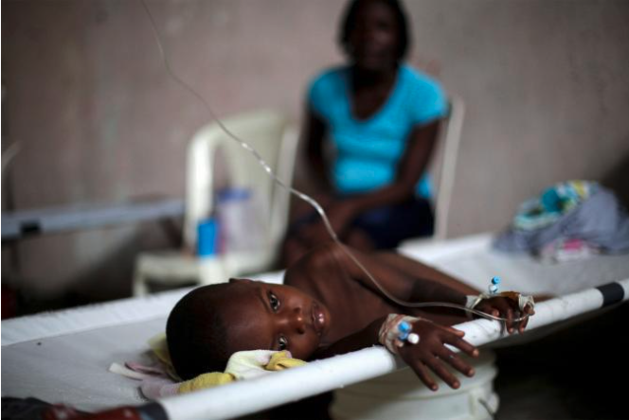
What is the treatment for Cholera?
The treatment for cholera is very simple!
The diarrhoea causes people to become so dehydrated they die. To stop that from happening, people with cholera just need to drink plenty of clean water.
In extreme cases, a sufferer may need to have IV fluids (fluid injected into the veins) and antibiotics to kill the bacteria.

Slide 12
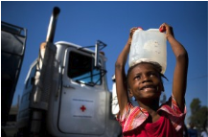
What aid has been given?
Since the 2010 earthquake in Haiti, agencies have been working continuously to reduce the threat of cholera. Every day, the Red Cross sends 2.4 million litres of clean water to more than 300,000 people living in camps in Port-au-Prince, and has built more than 2,500 latrines (a type of toilet).
There are also education programmes which teach people living in camps about how cholera is spread and how they can stop it i.e. washing hands thoroughly, preparing food safely.

Slide 13

Well done another week finished.

