Slide 1
IMPORTANT
IMPORTANT
As you may not have your jotter, work can be completed on paper or digitally. For example, on Microsoft Word.
If possible, you can share your work with your teacher by uploading to Teams taking a picture of your work and uploading it to Teams.
Submitted work will receive feedback but please note this will not happen instantly and feedback may not come from your class teacher but another member of the Humanities Faculty.
Stay safe everyone!

Slide 2
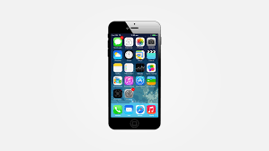
IMPORTANT
IMPORTANT
Scan a document on your iPhone
Open a note or create a new note.
Tap , then tap Scan Documents.
Place your document in view of the camera on your device.
If your device is in Auto mode, your document will be automatically scanned. If you need to manually capture a scan, tap or one of the Volume buttons.
Drag the corners to adjust the scan to fit the page, then tap Keep Scan.
You can add additional scans to the document or tap Save when you're done.

Slide 3
IMPORTANT
When uploading your work to Teams please follow the instructions below.​
​
1. Find and click on the Assignment tab at the top of the Teams’ screen.​
​
2. Click on the Assignment you want to upload your work to.​
​
3. Attach your work (photo/word doc/PowerPoint) using the upload document section.​
​
This means that your work is saved next to your name and can be clearly seen as being handed in by your teachers. **You should not be posting your work on the chat**​
​
If it comes up with an error message then try again later on in the day. If it still comes up with an error message then please post a message on the posts tab.​
***If you are taking a picture of your work, please only take portrait pictures (straight up and down).

Slide 4
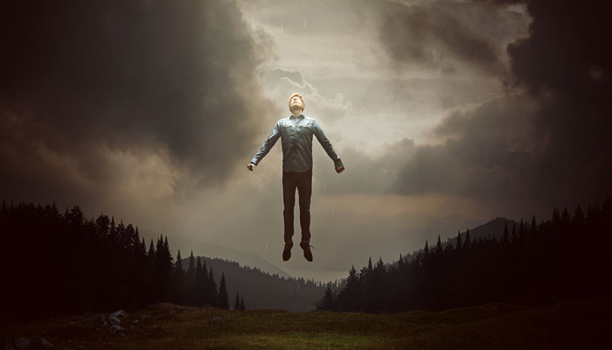
S2 RMPS
In S2 we are exploring the philosophical question ‘Is there Life After Death?’

Slide 5
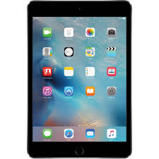

Life After Death Research Task
Learning Intention:
We are…
Researching ideas about a belief on life after death.
Success Criteria
By the end of the lesson I will be able to…
Use the internet to help me research and find out information.

Slide 6

Week One Task Instructions
Audio on this slide
Research a belief about life after death. Choose one from the following list:
  Greek Mythology
  Valhalla
  Reincarnation
  Heaven and Hell.
On the next slide, look at the box labelled success criteria and make sure you include each of the points in your research and poster.
By the end of this week’s lesson you should use the internet to do all research for your poster.
Next week you will be creating your poster.

Slide 7
TASK
Audio on this slide
Success Criteria
Your poster must include…
Explanation of what happens to the body after death.
Who are the key figures? (Gods, Goddesses)
The key beliefs
- where do they go?
- what happens?
- how are they judged?
Your opinion on the belief
Colourful and creative
Pictures
Choose a belief about life after death from the list below:
Greek Mythology
Valhalla
Reincarnation
Heaven and Hell
Your task is to produce an information poster on the belief you have chosen to research.

Slide 8
Success Criteria: Levels
Audio on this slide
Level 3 Gold
At least 2 detailed points on what happens to the body after death.
Explanation of the key figures of the belief (Gods and Goddesses)
Detailed explanation of the key beliefs including; an explanation of the journey to the afterlife, what happens when in the afterlife, how judgement is made.
At least 2 detailed reasons for their opinion on the belief they have chosen.
Level 3 Silver
At least 2 points on what happens to the body after death.
Description of the key figures of the belief (Gods and Goddesses)
Description of the key beliefs including; a description of the journey to the afterlife, what happens when in the afterlife, how judgement is made.
At least 2 reasons for their opinion on the belief they have chosen.
Level 3 Bronze
At least 1 point on what happens to the body after death.
Brief description of the key figures of the belief (Gods and Goddesses)
Brief description of the key beliefs including; a description of the journey to the afterlife, what happens when in the afterlife, how judgement is made.
At least 1 reason for their opinion on the belief they have chosen.

