Slide 1
Important
As you may not have your jotter, work can be completed on paper or digitally. For example, on Microsoft Word. ​
If possible, you can share your work with your teacher by uploading to Teams via the Assignment tab. ​​
Submitted work will receive feedback but please note this will not happen instantly and feedback may not come from your class teacher but another member of the Humanities Faculty.​
Stay safe everyone!

Slide 2
Important
Scan a document on your iPhone​
Open a note or create a new note.​
Tap , then tap Scan Documents.​
Place your document in view of the camera on your device.​
If your device is in Auto mode, your document will be automatically scanned. If you need to manually capture a scan, tap or one of the Volume buttons.​
Drag the corners to adjust the scan to fit the page, then tap Keep Scan.​
You can add additional scans to the document or tap Save when you're done.

Slide 3
Important
When uploading your work to Teams please follow the instructions below.​
1. Find and click on the Assignment tab at the top of the Teams’ screen.​
2. Click on the Assignment you want to upload your work to.​
3. Attach your work (photo/word doc/PowerPoint) using the upload document section.​
This means that your work is saved next to your name and can be clearly seen as being handed in by your teachers. **You should not be posting your work on the chat**​
If it comes up with an error message then try again later on in the day. If it still comes up with an error message then please post a message on the posts tab.​
***If you are taking a picture of your work, please only take portrait pictures (straight up and down).

Slide 4

The Home Front: Evacuations (PART TWO)
Learning Intention: We are learning about evacuations during WW2.
Success Criteria: I can explain why people were evacuated.
I can describe what life was like for evacuees.

Slide 5
Starter Task
Think back to what you learned last week….
Are the following statements true or false?
1. Children were evacuated to protect them from French bombing.
2. Children were sent to areas known as ‘reception’ areas.
3. A ‘billeting officer’ had the role of finding children homes.
4. Evacuations began in 1942.
5. Children were evacuated from Glasgow.

Slide 6
The government recommended that in addition to their gas mask and identity card the evacuees had the following items:
Other items
Overcoat or mackintosh
Comb
1 pair of Wellington boots
Towel
Soap
Facecloth
Toothbrush
Boots or shoes
Plimsolls
Sandwiches
Packet of nuts and raisins
Dry biscuits
Barley sugar (rather than sugar)
Apple
Girls
Vest
Pair of pants
Petticoat
2 pairs of stockings
6 handkerchiefs
Slip (like a very long vest with shoulder straps)
Blouse
Cardigan
Boys
2 vests
2 pairs of pants
Pair of trousers
2 pairs of socks
6 handkerchiefs
Pullover or jersey

Slide 7
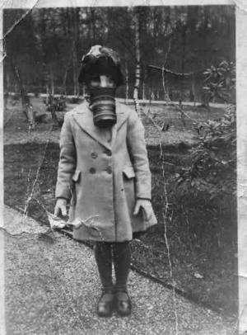
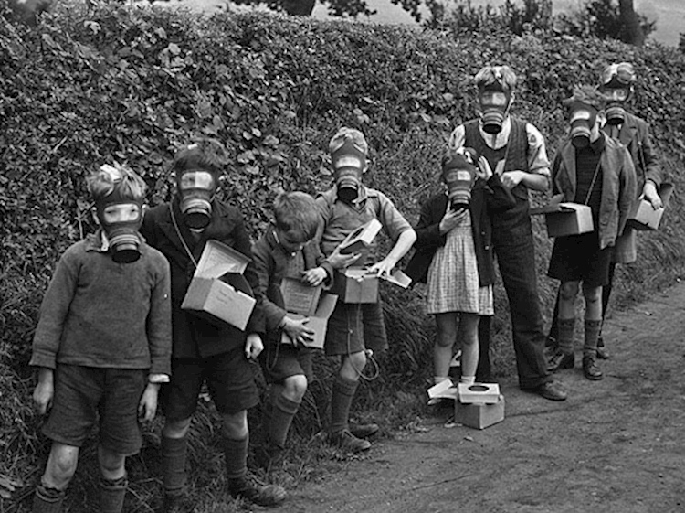
Children had to carry gas masks in case of an attack

Slide 8

Activity 1 - Evacuees Belongings
Evacuees could not take much from home with them to their new home.
If you could choose 8 things to take with you if you were evacuated back during the time of WW2, what would those 8 things be?
Write your 8 items down and say WHY.

Slide 9

How would children of today cope if evacuated?
https://www.youtube.com/watch?v=kRt5Mk6V8Gg
Whilst watching the episode, take brief notes on what life would have been like for evacuees during WW2.
Notes:
https://www.youtube.com/watch?v=0_VIKNDECOA

Slide 10
Activity 2 - Describe Question
YOU MAY NEED TO USE LAST WEEKS NOTES/POWERPOINTS TO HELP YOU.
There is help on the next slide for how to write your answer if you need a bit extra support.
Describe the experience of an evacuee during World War 2. (4 marks so you should mention 4 things – try to write your answer as a paragraph)
Things to consider for your answer:
what was the journey like – how did they travel and where to?
What were they allowed to take with them? Provide a few examples
what happened when they arrived in their new village/town – how were assigned a new family?
what did they experience in the countryside?

Slide 11
Structure help for your answer…
You don’t have to use this – only use it if you feel like you need a little bit extra help!
Describe the experience of an evacuee during World War 2. (4 marks)
Evacuess during WW2 travelled on a ______ to areas in the country such as ___________________. Evacuees were allowed to take a small amount of belongings such as _____________, ____________ and _____________. When evacuees arrived in their new village, a _______________ had the role of finding them a new home. Being in the countryside was different for many evacuees because __________
____________________________________.

Slide 12
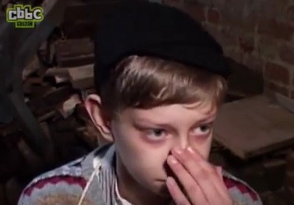
Activity 3 - Send a Letter Home
Imagine you are an evacuee during World War 2. You have moved from a large city to live in a small village in the countryside with a family you have never met before.
Write a letter back home to the rest of your family who are still in the city.
What should I write in my letter?
Where you have been evacuated to.
Your understanding of why you have been evacuated
Your feelings about being evacuated
What your new life is like in the countryside – provide information on what the family you live with are like, what school is like and what activities you do

Slide 13
How much have you learned?
Match up task – match up the evacuation related words with their definition… at the moment the columns don’t match!
Billeting Officer An area NOT involved in evacuations
Neutral Area All children had to carry one of these
Evacuee Transport used to transport evacuees
Gas Mask An area that accepted evacuees from cities
Reception Area Had to find evacuees a new home/family
Train Name given to a child being evacuated from home

