Slide 1
IMPORTANT
As you may not have your jotter, work can be completed on paper or digitally. For example, on Microsoft Word.
If possible, you can share your work with your teacher by uploading to Teams taking a picture of your work and uploading it to Teams.
Submitted work will receive feedback but please note this will not happen instantly and feedback may not come from your class teacher but another member of the Humanities Faculty.
Stay safe everyone!

Slide 2

IMPORTANT
Scan a document on your iPhone
Open a note or create a new note.
Tap , then tap Scan Documents.
Place your document in view of the camera on your device.
If your device is in Auto mode, your document will be automatically scanned. If you need to manually capture a scan, tap or one of the Volume buttons.
Drag the corners to adjust the scan to fit the page, then tap Keep Scan.
You can add additional scans to the document or tap Save when you're done.

Slide 3

The Need for Change
Learning Intention:
We are…
Exploring the effects of the Dunblane Massacre on individuals and the wider community.
Success Criteria:
I will be able to…
Give examples of how suffering can bring communities together.
Produce a piece of creative writing highlighting the need for change.

Slide 4
Week Six Tasks
Complete the question on slide 5, you can use the internet to help you find some examples.
Read through the Telegram from the Pope on slide 7 and use a dictionary to help you find out the meanings of the key words: Fervent and Senseless.
Begin letter writing task on slide 8.
Letter writing task: follow the instructions on slide 8 and use the template on slide 9 to set out your letter.
You can use the internet to help you get more information about the incident or watch news clips on youtube to find out the reactions from parents and residents.

Slide 5
Can good ever come out of suffering?
Sometimes bad things happen to good people…
Sometimes we don’t know why…
Sometimes people need to focus their anger and their grief on to something else….
Question:
Can you think of anything good which has come out of the Dunblane massacre?
You can use the internet to help you find some examples.

Slide 6
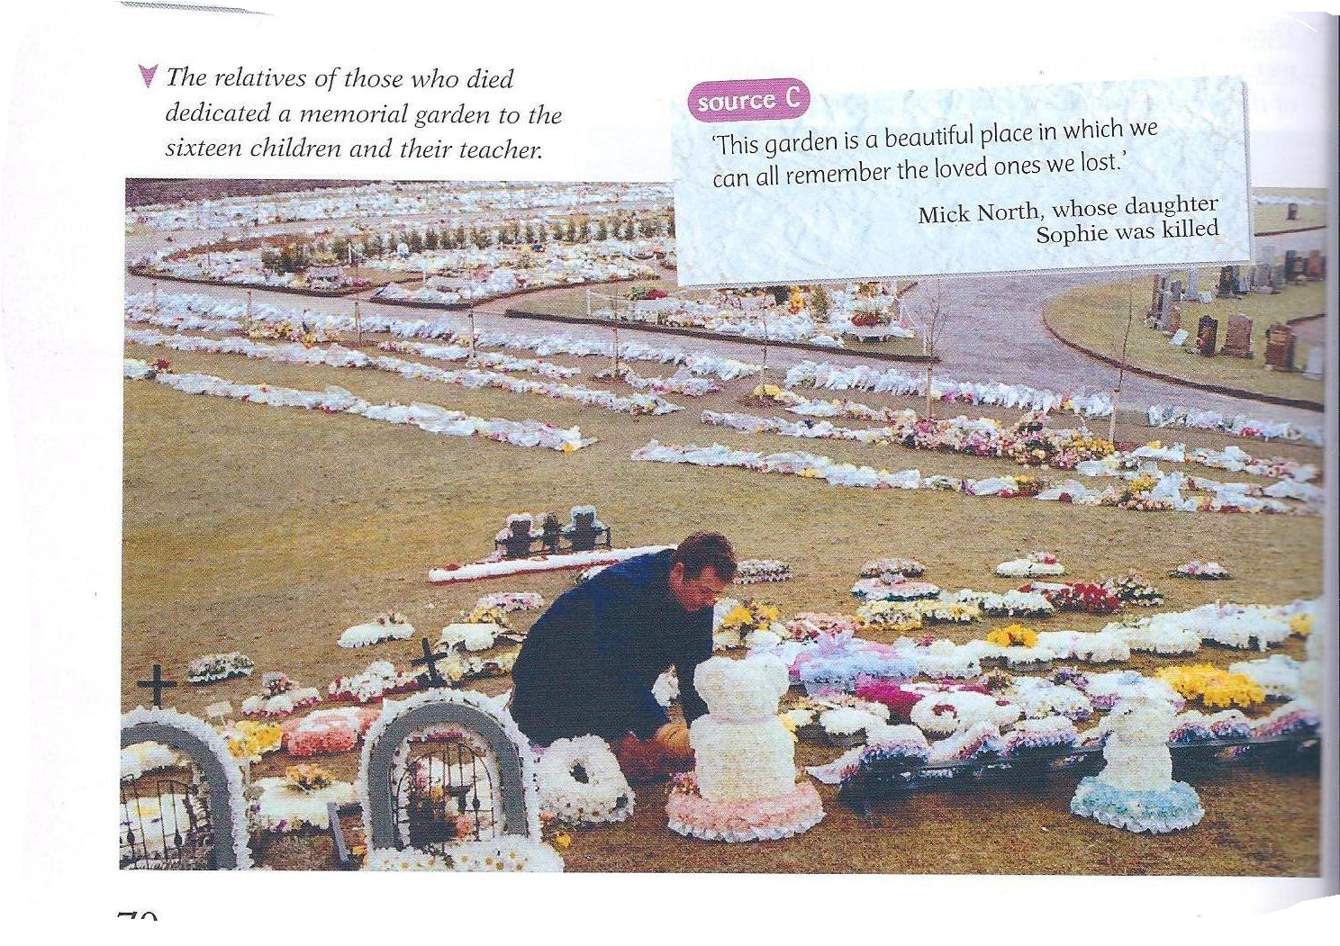


The relatives of those who died dedicated a memorial garden to the sixteen children and their teacher.
B
The case forced the government to revisit the UK gun laws.
A
C
Some parents launched the ‘Dunblane Tartan Ribbon Appeal.’
The money raised is given to the Save the Children organization. It is then used to help children suffering all over the world
A mother of a child murdered [Liz Mc Lennan]
‘I lost my daughter and I felt that I would really want to help children all over the world, and in this country, who are suffering from crime and suffering generally.’

Slide 7
Telegram from the Pope
`The Holy Father offers fervent prayers for the families and friends of the victims and for all mourning their loss. He invokes God's consolations upon all those suffering as a result of senseless violence and he sends his blessing.''
The Vatican sent a message
expressing sympathy to Dunblane.
Use a dictionary to help you find out the meanings of the following key words:
Fervent:
Senseless:

Slide 8
Letter Writing Task
You are the parent of a child who was killed during the Dunblane Massacre.
You are writing a letter to the prime minister asking for change so that an incident like this never happens again.
Things to include in your letter;
A short description of the incident
How you feel and how it has affected you as a parent and your family
How it has affected your community
What changes you think should be made to stop this from ever happening again.

Slide 9
Joe Bloggs,
21 Dunblane Avenue,
Dunblane,
FK3 21H
Prime Ministers Office
10 Downing Street,
London
13th MARCH 1996
Dear Mr Prime Minister,
Sincerely,
Your Name

