Slide 1

Strong Passwords
Internet Security

Slide 2
“If you want to be happy, be”.
IUw2B:)B.

Slide 3
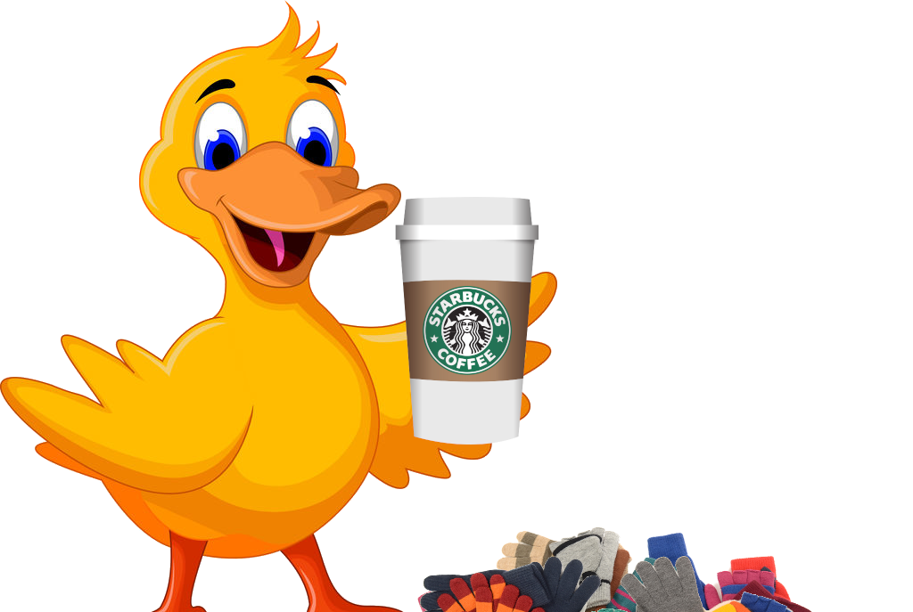
Cartoon-Duck-14-Coffee-Glvs

Slide 4

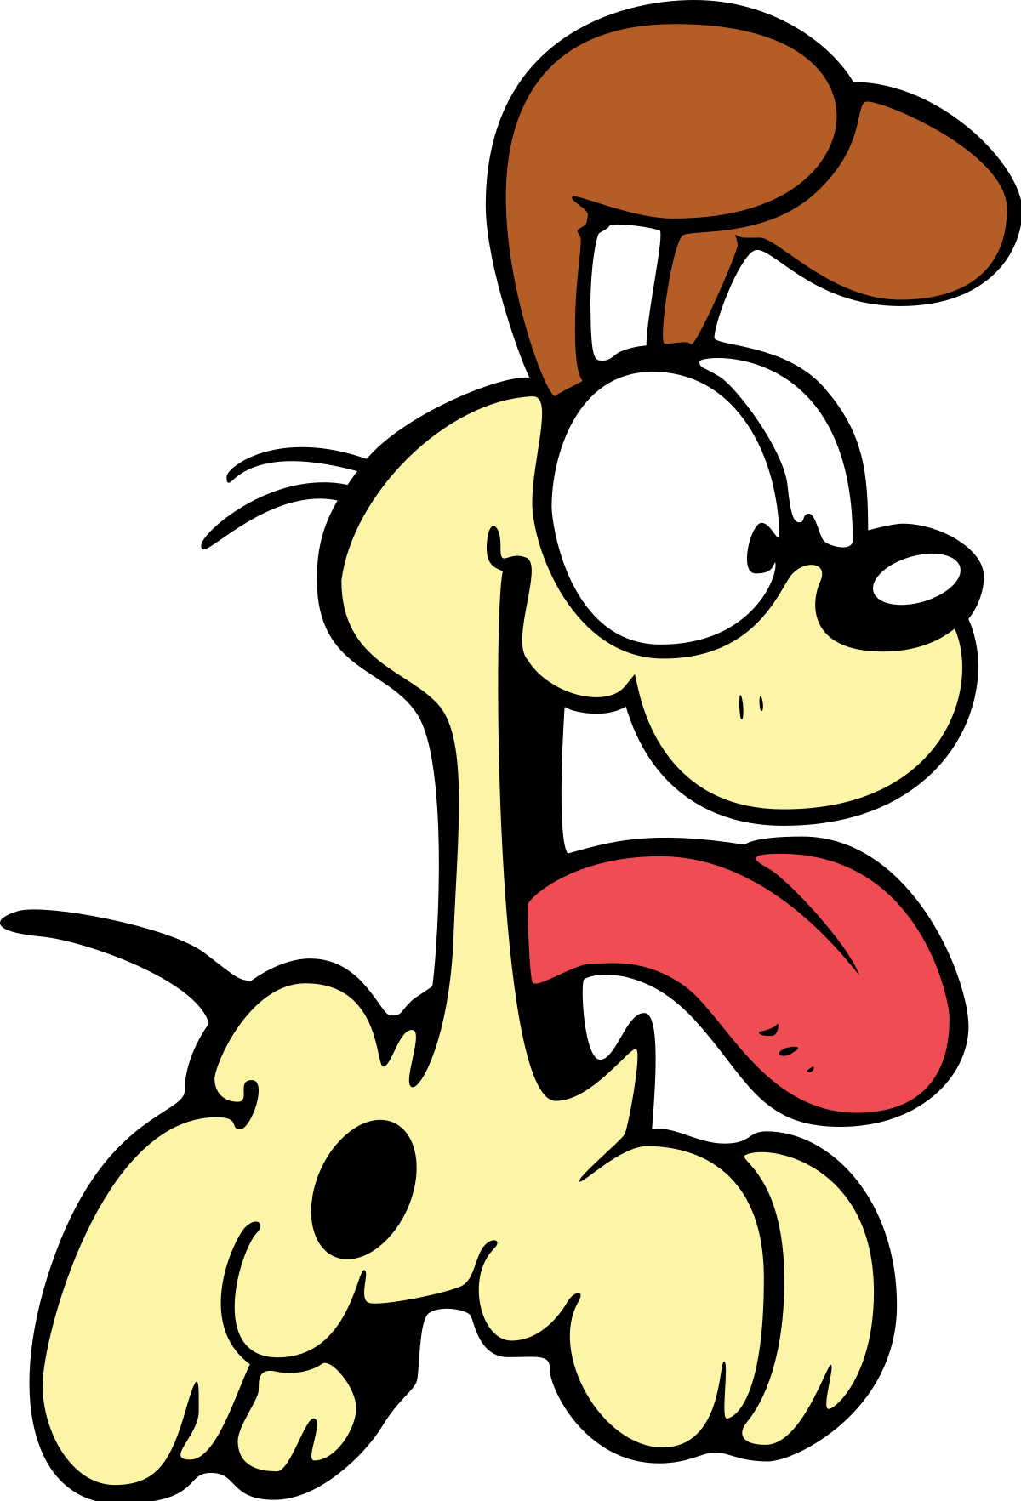
Dog.lov3r
dOG.lov3r
i7ovemydog!!

Slide 5
OK Password | Better Password | Excellent Password
kitty | 1Kitty | 1Ki77y
susan | Susan53 | .Susan53
jellyfish | jelly22fish | jelly22fi$h
smellycat | sm3llycat | $m3llycat
allblacks | a11Blacks | a11Black$
usher | !usher | !ush3r
ebay44 | ebay.44 | &ebay.44
deltagamma | deltagamm@ | d3ltagamm@
ilovemypiano | !LoveMyPiano | !Lov3MyPiano
Sterling | SterlingGmal2015 | SterlingGmail20.15
BankLogin | BankLogin13 | BankLogin!3

Slide 6
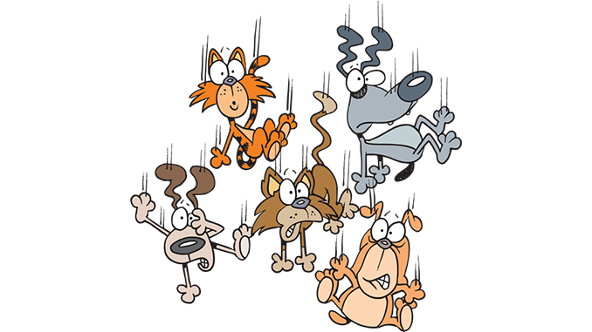

It is raining cats and dogs!
1tsrAIn1NGcts&DGS!
Pass Go and collect $200”
p@$$GOandCLCt$200

