Slide 1



Audio recording using OneNote.

Slide 2
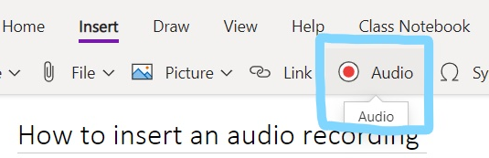

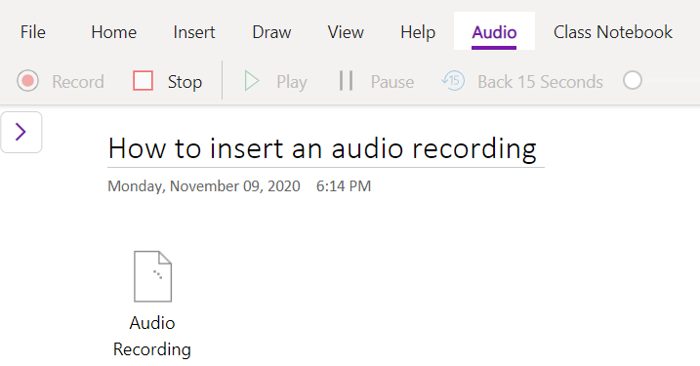

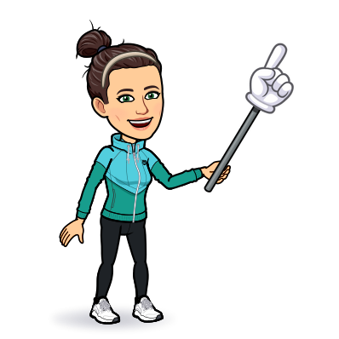
Recording will start as soon as the button is clicked.
REMEMBER:
You can pause, stop and delete then start again.
Your recording will show up like this right from the start.

Slide 3

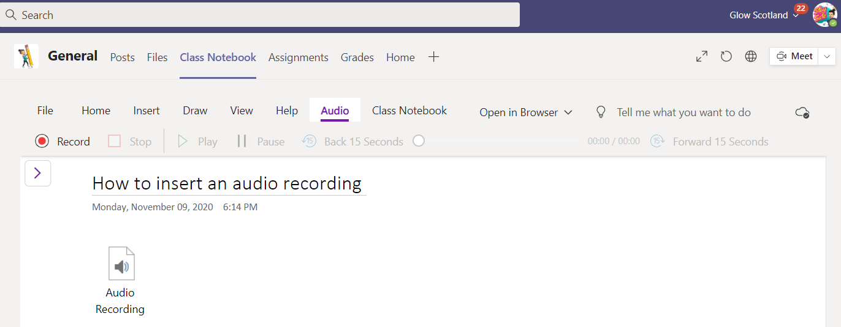
Your audio recording will look like this.
Just click on it to hear it.

Slide 4
