Slide 1


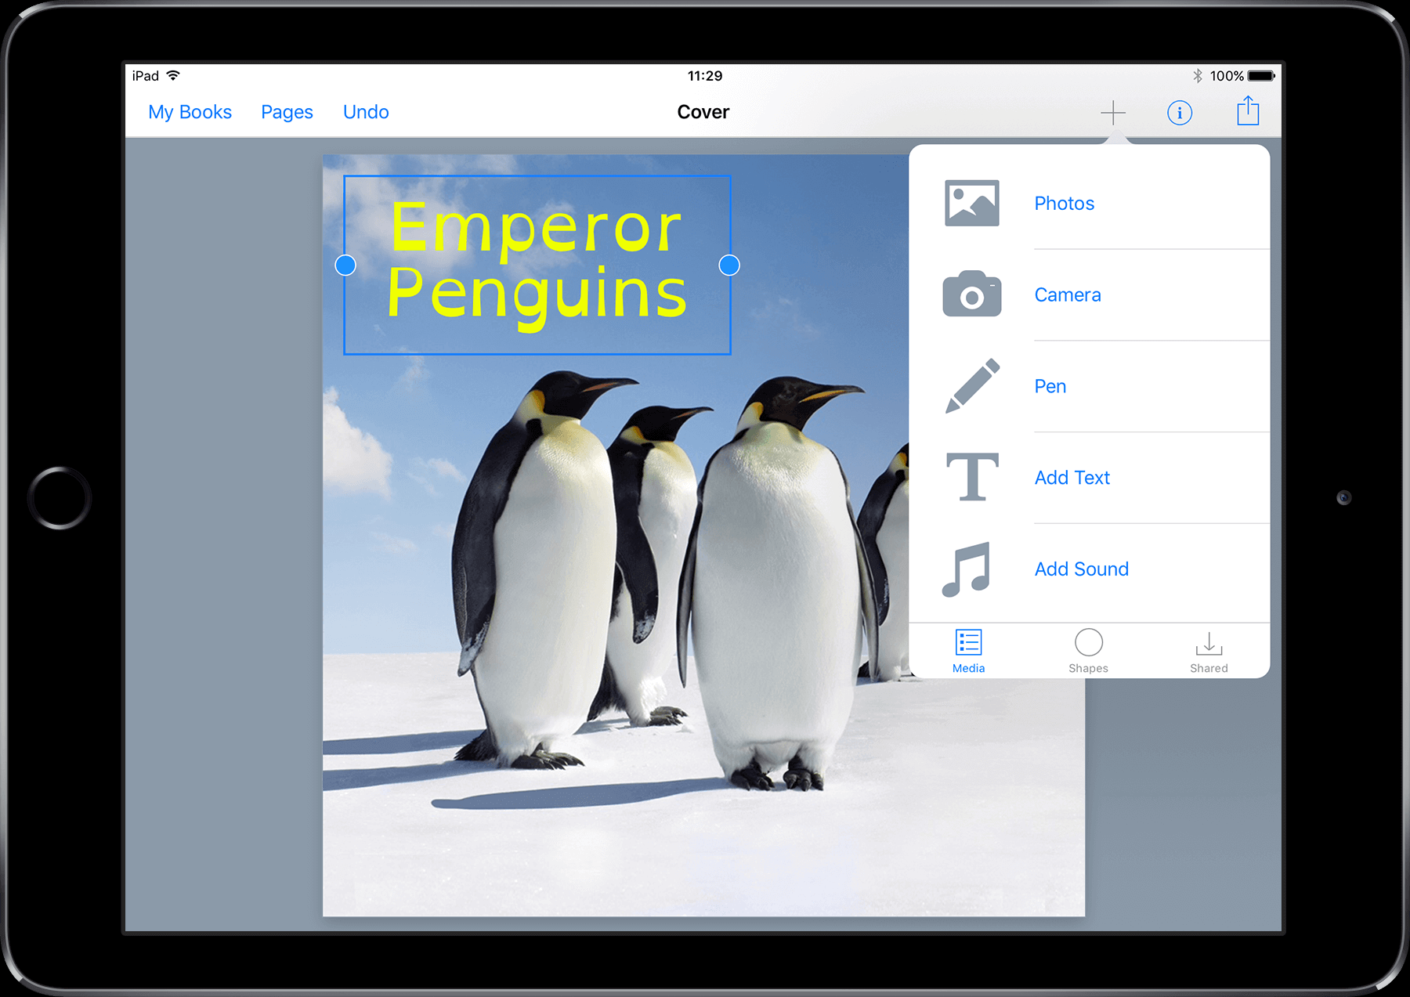

Using Book Creator to Support Literacy, Organisation and Communication Skills
Gillian McNeill
14th June 2017

Slide 2

Communication, Access, Literacy and Learning
National service
  providing Assistive Technology support
  providing Augmentative and Alternative Communication (AAC) support
Funded by Scottish Government and Local Authorities
Located within the University of Edinburgh
Notes:
Background information about CALL Scotland
- gives context for day, how we have arrived at eye gaze
Operating for over 30 years , with a role that has evolved and developed over that period.
National service supporting people to use AT and Augmentative and Alternative Communication.
Scottish Government funding which is from the learning directorate, our primary role is supporting children in education, with pupil assessments and follow up funded directly by certain local authorities
Located within the university (bearing with us with all the building work going on around us).
Through work carried out in CALL roles that we have become more and more involved in assessing and advising on eye gaze, now a standard part of assessment toolkit. As we have an increasing number of queries to team about using eye gaze, we are eager, as well as providing appropriate individual support, but wider sense, we want to share this specialist information and to develop resources for anyone to make use of.

Slide 3
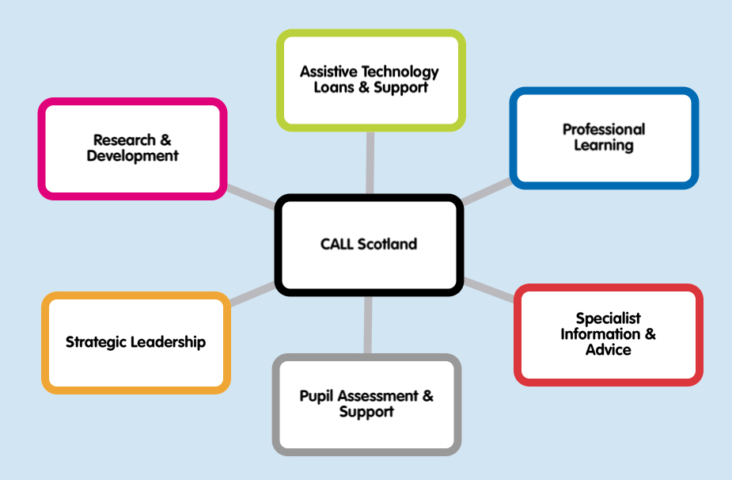
Notes:
CALL roles/ work areas
Strategic Leadership (to develop policy and good practice)
Working with key partners SQA, National Parent Forum Scotland amongst others
Research & Development (informing development of approached and resources)
Scottish text-to-speech computer voices, Books4All digital book database, Resources for AAC
Assistive Technology Loans & Support
Extensive loanbank AT & AAC devices
Professional Learning
CALL-live webinars and courses
Specialist Information & Expert Advice
Publications, website & social media networking
Pupil Assessment & Support
Primarily delivered through SLAs

Slide 4
Why choose Book Creator?
App for creating eBooks
Versatility in supporting learning and communication
Available on iPad, Android, Windows and Chrome
Features including multi-media, appearance and style options
Multiple sharing options
Range of resources and support from developer
Fun and easy to use
Inexpensive

Slide 5
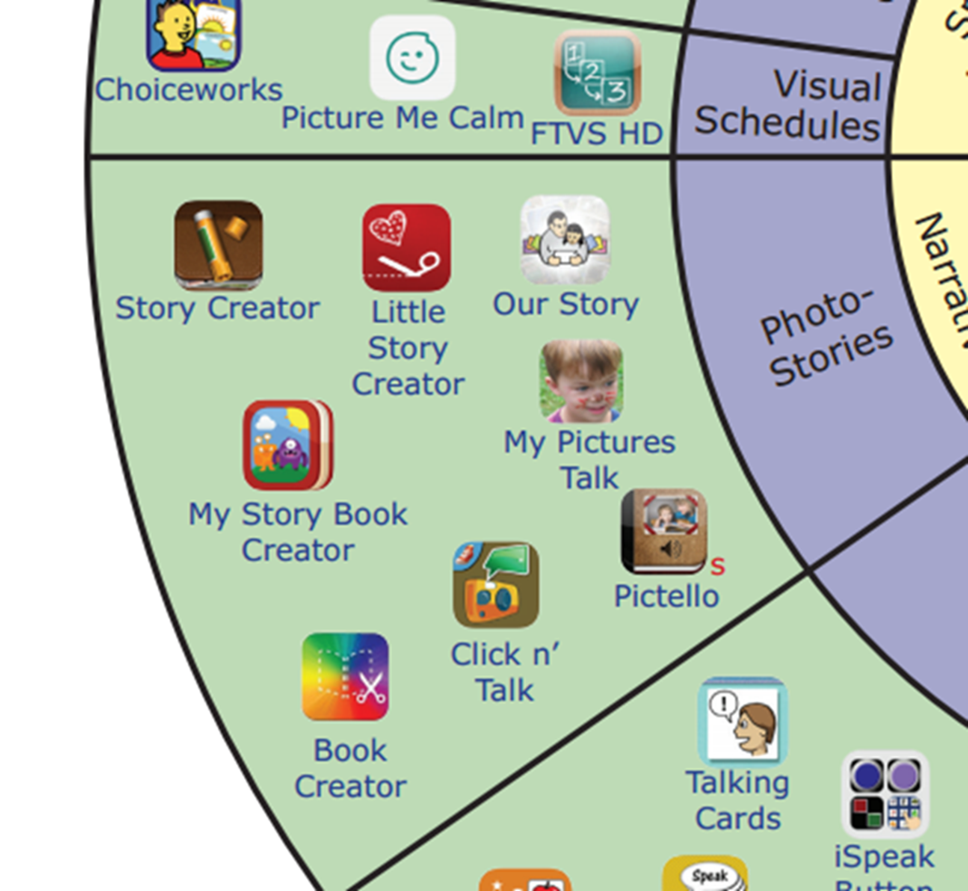

Other eBook Apps
Story Creator - free
My Story Creator – School Edition - £3.99
(also free Kids Edition)
Pictello - £19.99

Slide 6

Book Creator One
Free
One book
Delete book and make another
No comic templates
All features available when creating standard book
Export options excluding publishing online

Slide 7

Book Creator
£4.99
Multiple books with Bookshelves
Comic templates
All features available when creating standard book
Full export options including publishing online

Slide 8


Other platforms
Google Play - £1.50
Windows store - free

Slide 9
Sharing options
Export as ePub
iBooks on iPad
AirDrop or email, Dropbox, Google Drive etc.
Export as PDF
Export as Video
Publish Online via private link

Slide 10
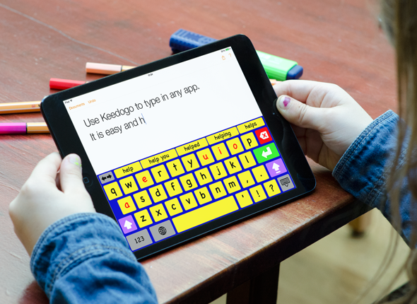

Supporting Writing
Keedogo Plus Keyboard App - £2.99

Slide 11
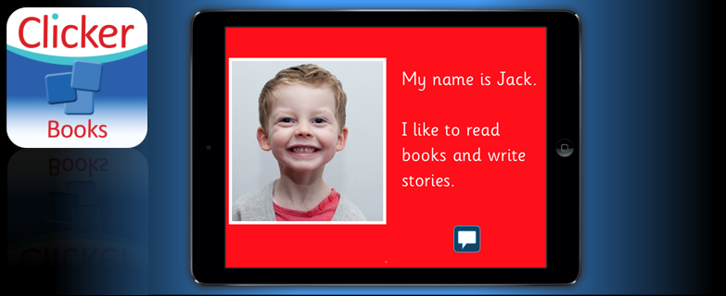
Clicker Books

Slide 12
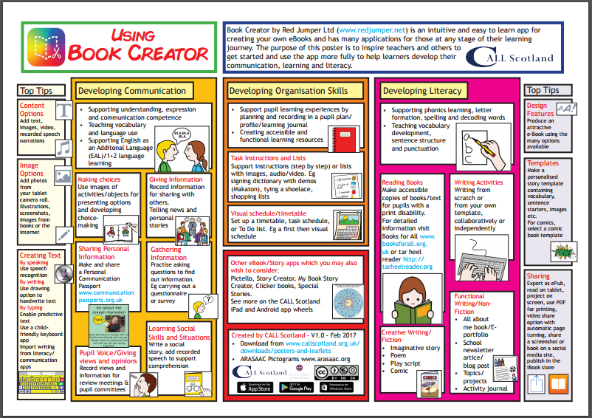

Slide 13
Links and Resources
gillan.mcneill@ed.ac.uk
www.bookcreator.com
Support videos https://www.youtube.com/user/bookcreatorapp
www.callscotland.org.uk
  Poster
  Webinar
  Blogs
  Professional Learning

