Slide 1

Study Skills

Slide 2

Top Tips
Get organized and don’t leave till the last minute.
Stay positive
Ask questions or for help.
Avoid distractions (phone away)
Make it fun.
Short and frequent sessions.
Sleep, Exercise and Diet are also important.

Slide 3
How can I Study?
Role play | Facts and Visuals | Mnemonic | Flash Cards
Quiz | Subject Dictionary | Chunking information | Label diagrams
Create a game | Teach someone | Discuss | Debate
Create audio notes | Mindmaps | Listen to notes | Re-write
Read, Read, Read | Create video notes | Book Creator | ThingLink
Wakelet | Past papers | BBC Bitesize | Posters

Slide 4

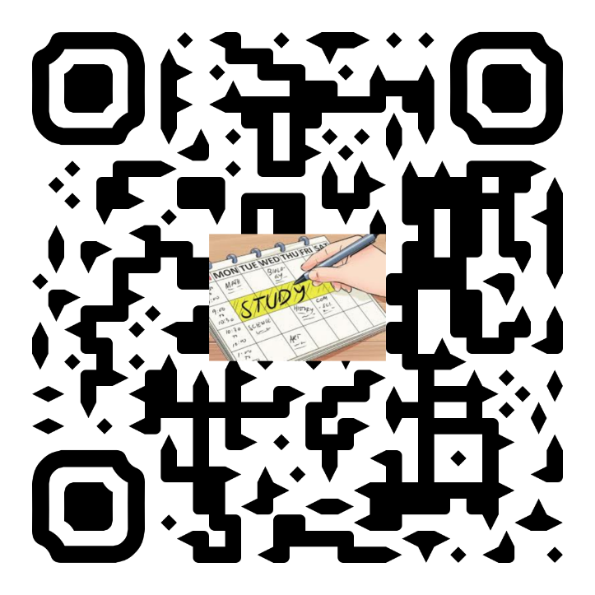
Create Study Skills Resources Online

Slide 5

Note Taking Tips
Read a section of text, pause to think about what is important, then write it down.
Don’t always write in sentences or word for word. Bullet points or short sentences.
Use headings to split information up.
Leave space to add more notes later.
Highlight anything you think is really important.
Add your own thoughts.
Used colour, images, or create your own legend in the markings.

Slide 6
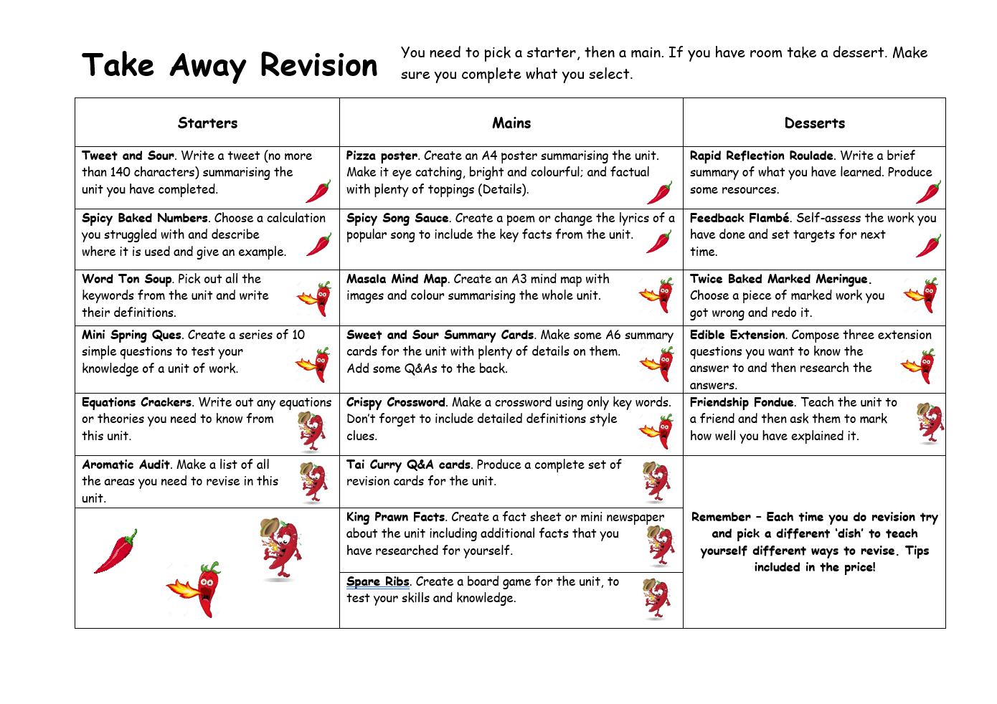
Take Away Revision

Slide 7


Revision
The memory hooks can be anything – an emotion, an image, a place, a person, a piece of music…
Find something that you can use to trigger your memory, and you will find it easier to remember the things you are trying to learn.

Slide 8

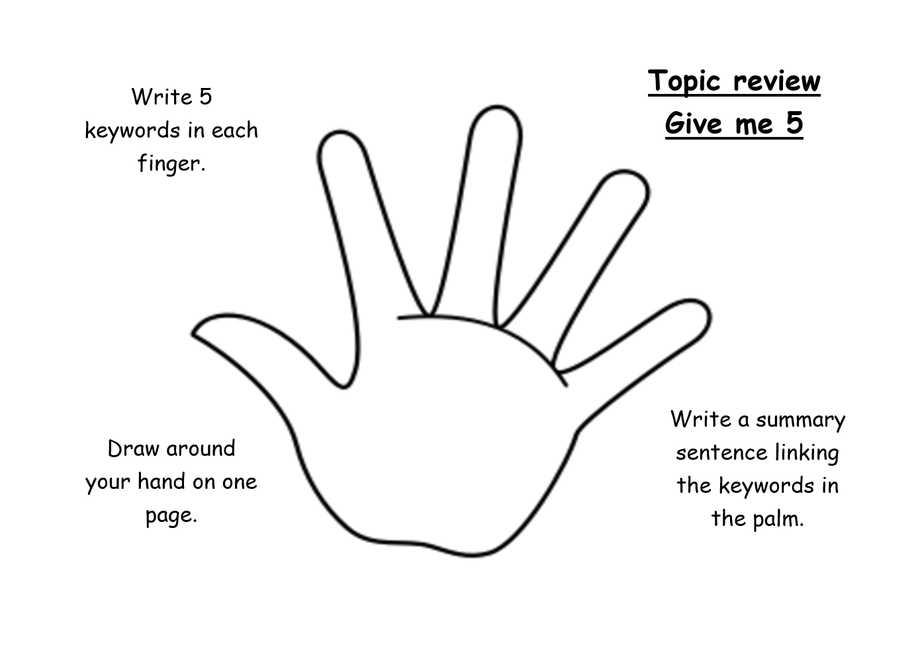
Ideas
What subjects do you think these ideas could be used for?

Slide 9
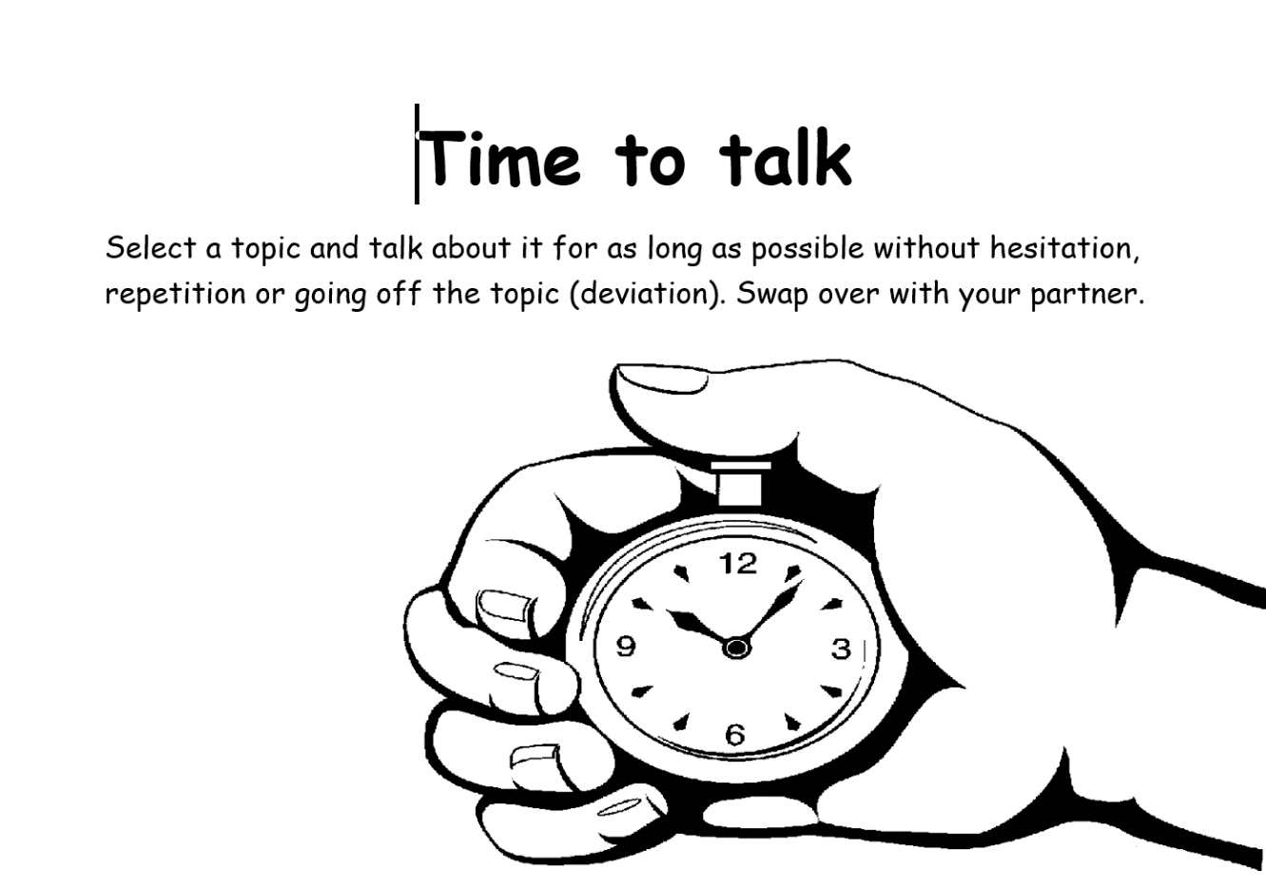
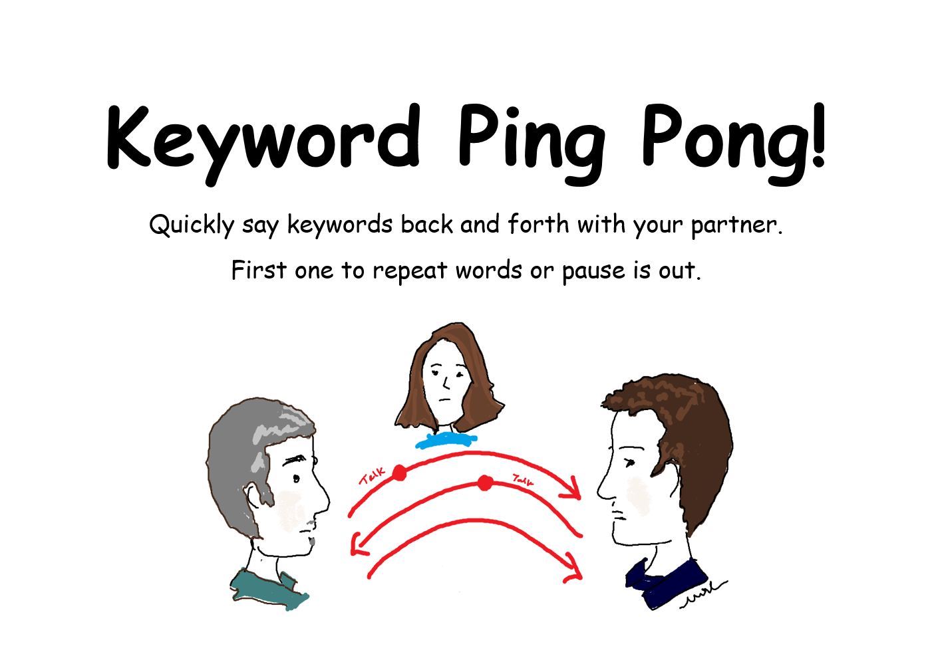
Talking

Slide 10
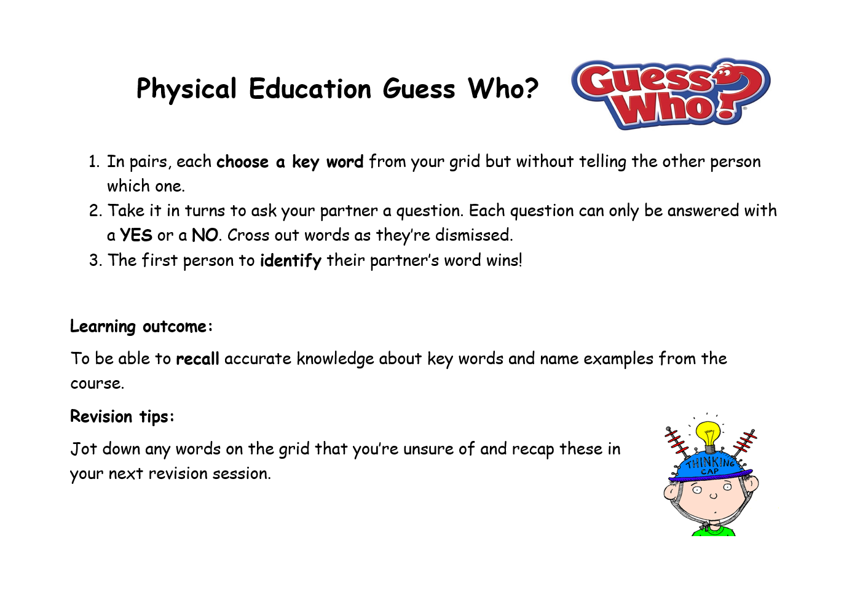
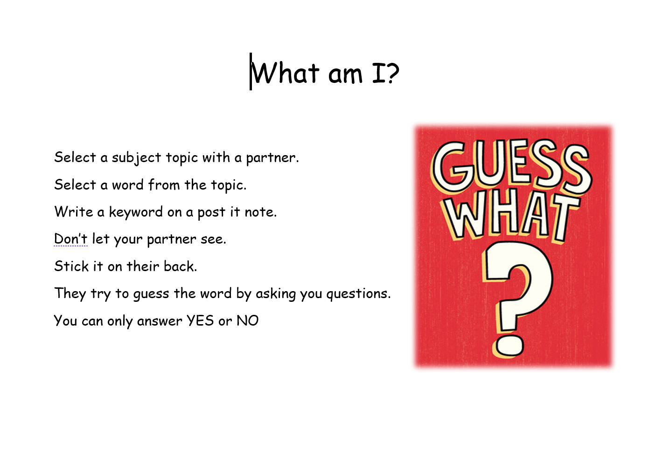
Games

Slide 11
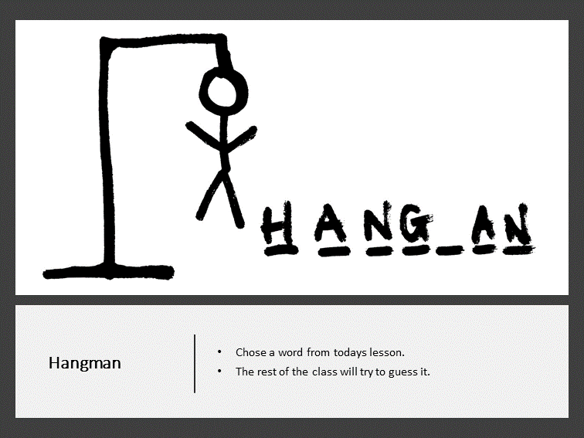
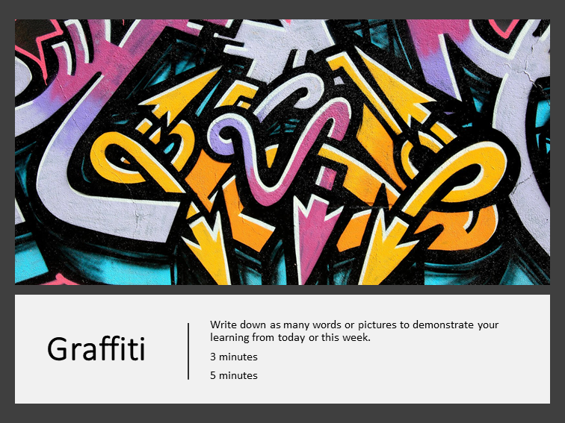
Ideas

Slide 12
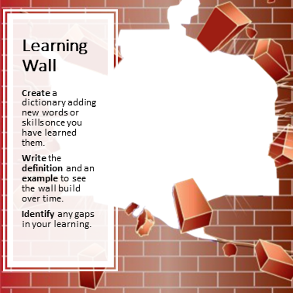
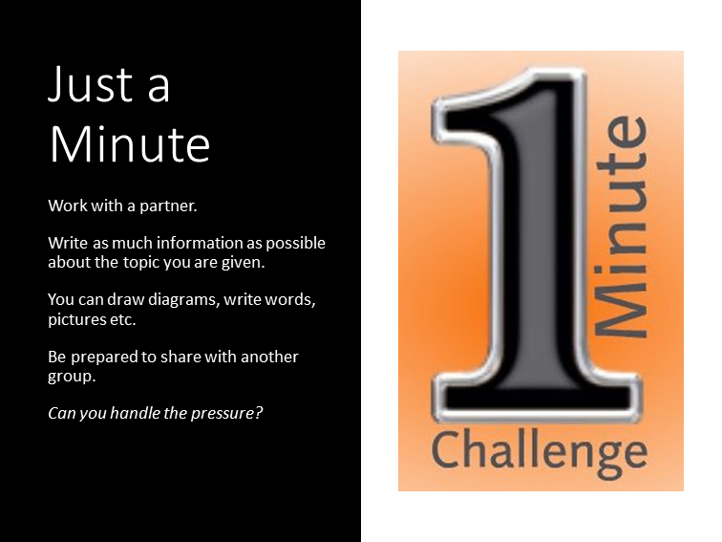
Ideas

Slide 13

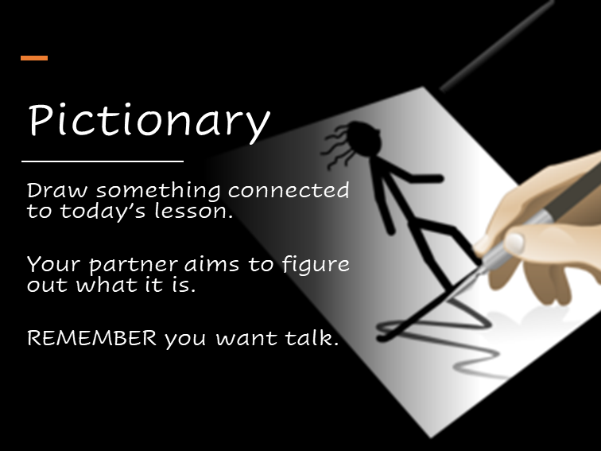
Ideas

Slide 14
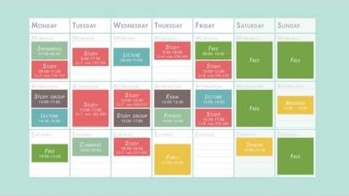
Create a study plan

