Slide 1

Study skills

Slide 2


hOW DO YOU STUDY?
Have you ever really thought about this?
Do you think the way you study is effective?

Slide 3

Finding your study style
There are many different ways to study. However, the methods you use to effectively study may not work for someone else.
Find what works for you!
We are all different, we learn in different ways and we effectively study in different ways too.
Don’t be afraid to try somethings new. There is time…

Slide 4

WHEN MIGHT YOU USE your study SKILLS?
School: prelims, exams, assessments, assignments
College/University: exams, assessments, assignments
Career: exams, projects, presentations
Job applications/interviews
Theory driving test

Slide 5

plan & Be organised!
This skill is extremely important in all aspects of life.
Not everyone is naturally organised. However, you can develop your organisational and planning skills.
What can you do to be more organised?
In what ways can you plan?

Slide 6
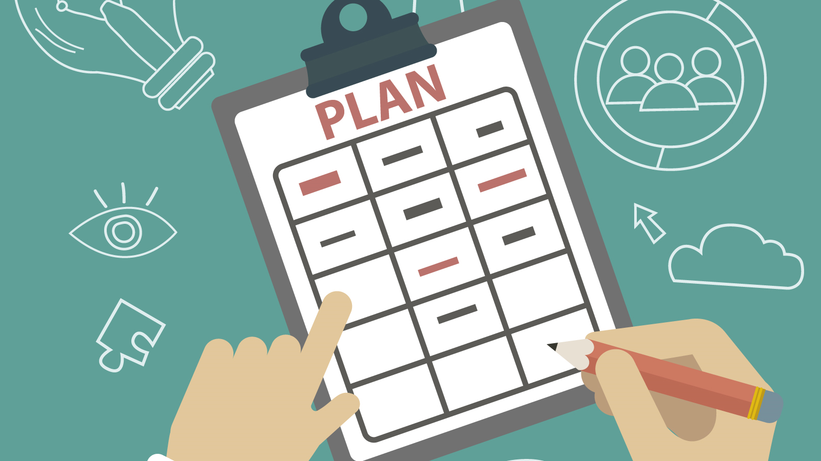
Planning for effective home study
Planning is key to success
Think of what you need achieve/cover and in what timescale
Think about barriers and distractions to learning at home

Slide 7

What are your barriers & distractions?
Do you procrastinate?

Slide 8
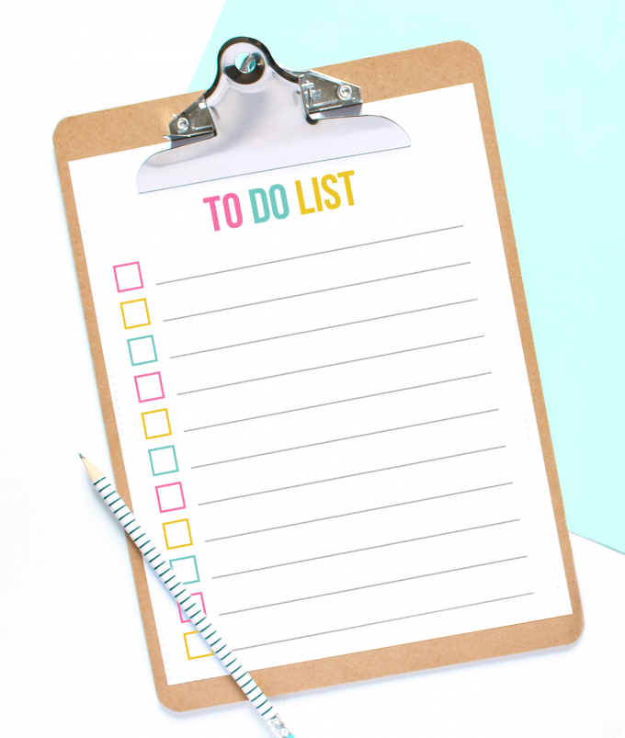
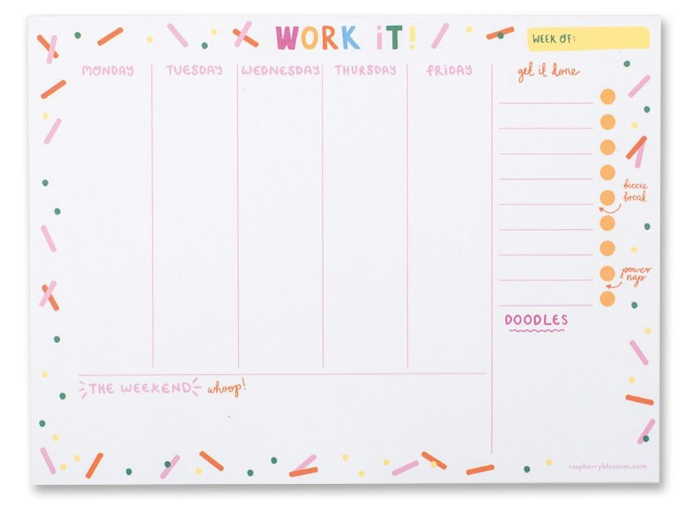
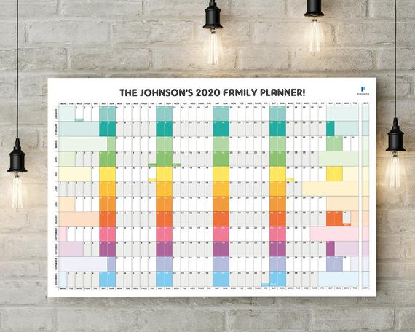
plan
Start planning. This doesn’t have to be perfect or set in stone but identify what needs to be done and in what time frame.
Identify all subjects/levels
Identify key dates (prelims, assignments/assessments/when homework is most often due)
Identify how long you spend on homework each week for each subject
Identify those subjects you find most difficult (be careful not to forget about all other subjects though)

Slide 9
Creating your plan
I recommend creating a plan each week or fortnight. First of all make a to-do list of what you need to consider (homework due/work/social plans etc.)
Identify days/evenings when you can study
Decide how long you intend to study for each day
Identify days/times you will complete homework
Identify when you will study for each subject (45 mins – 1 hour periods)
Set short term goals & rewards

Slide 10



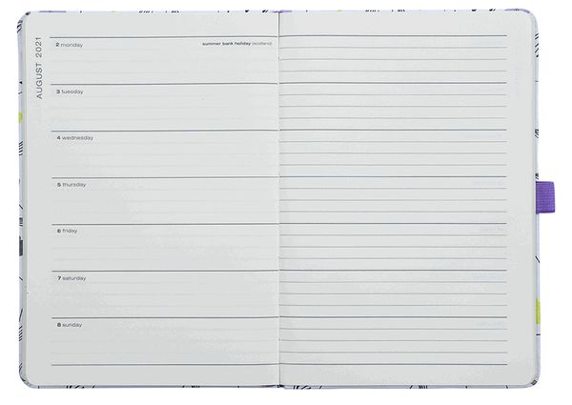
What can help you plan?

Slide 11

STUDY PLAN TASK

Slide 12

Prioritise your studying
Think about each of your subjects topics and how confident you feel about them in terms of:
Knowledge
Revision notes
Practice questions
Ask your teachers for subject check-lists or refer to the SQA course specification.
Grade this and spend more time on the areas you have difficulty with!

Slide 13


When studying…
Keep hydrated. Drink lots of water. Be careful not too drink too much caffeine – however tea and coffee breaks can help.
Snacks – balance between sugary and heathy snacks.
Limit amount of time spent on mobile phone.
Decide if music helps or distracts.
Take short breaks – get fresh air.

Slide 14
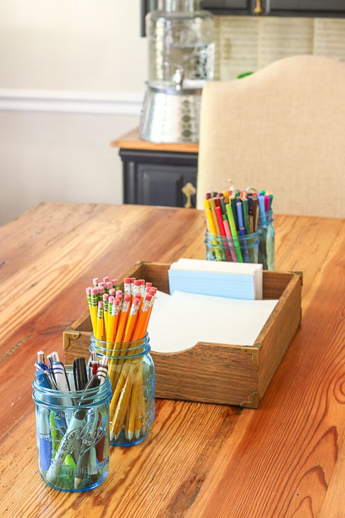

Your study space
If possible, create a dedicated study area

Slide 15

Prelim Preparation
Timetable
Exam technique
Study skills

Slide 16


Exam technique
Decoding the question
How do you pass exams?
Read the question
Answer the question
Sounds simple
but how do you do this effectively?

Slide 17

Exam technique
Command words (clues)
Exam questions have key words which help you to work out what the question is asking you to do.

Slide 18
Exam technique
You can answer the questions in any order.
Pick one you are confident with to start.
If you are unsure or can’t remember an answer, leave it and go back at the end.
It is more important to answer all the rest first.
Don’t score out any answer (even if you think it is wrong) until you have written a new one.
Attempt all questions if you are able to.

Slide 19
Exam technique
This is your paper and you can write anything extra on it that will help you!
Circle or underline important information when reading questions.
Write or draw any extra information onto the diagrams given, if that helps you.
Any words in bold are especially important for you to take notice of and use e.g. using the information given.

Slide 20


Study Techniques

Slide 21

understanding
How do you know you understand?
Note making/summarising
Answering questions

Slide 22
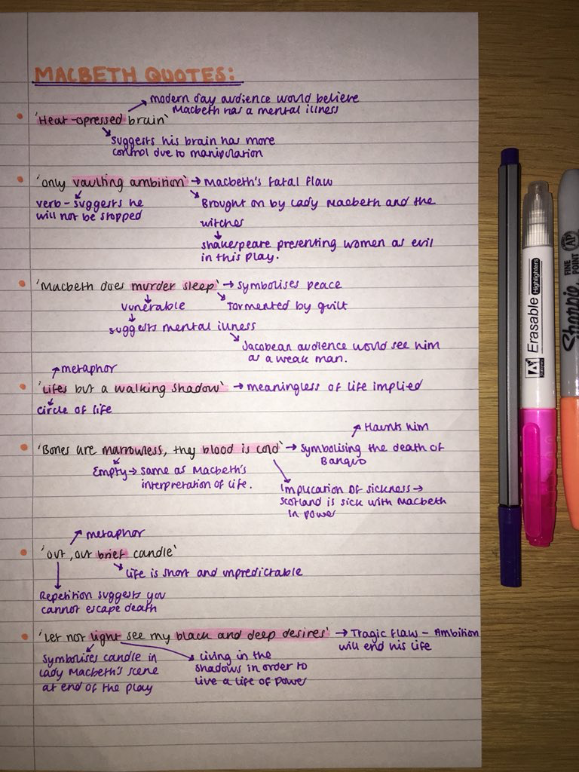
Note making/summarising
Take your notes and pick out the key information by making
Bullet points
Listing all of the facts you can remember
Create a PowerPoint/word document
Using your notes
How can you actively understand your notes?
Colour coding
Visualising

Slide 23

Answering Questions
Class worksheets (or other resources)
Textbooks or revision books
Homework questions
Past paper questions
Online quizzes or apps
Flashcards

Slide 24
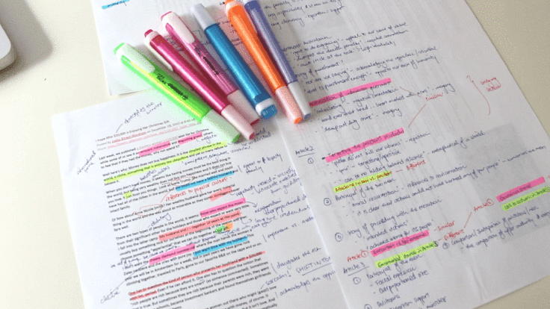

COLOUR CODING
Take your notes and colour code or highlight the important information.
This is to help you find key words or phrases in a paragraph.
It is not to end up with the whole page of notes coloured in!

Slide 25


Reading notes
Simply reading over your notes or the course textbook can be a helpful technique for some people.

Slide 26

VISUALING
When memorising information:
Try closing your eyes and writing the information in the air or on a surface with your finger.
Try to picture the words in your head as you are doing this.
Try to hear the words in your head, too.

Slide 27
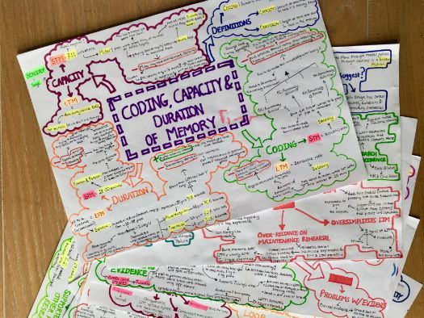
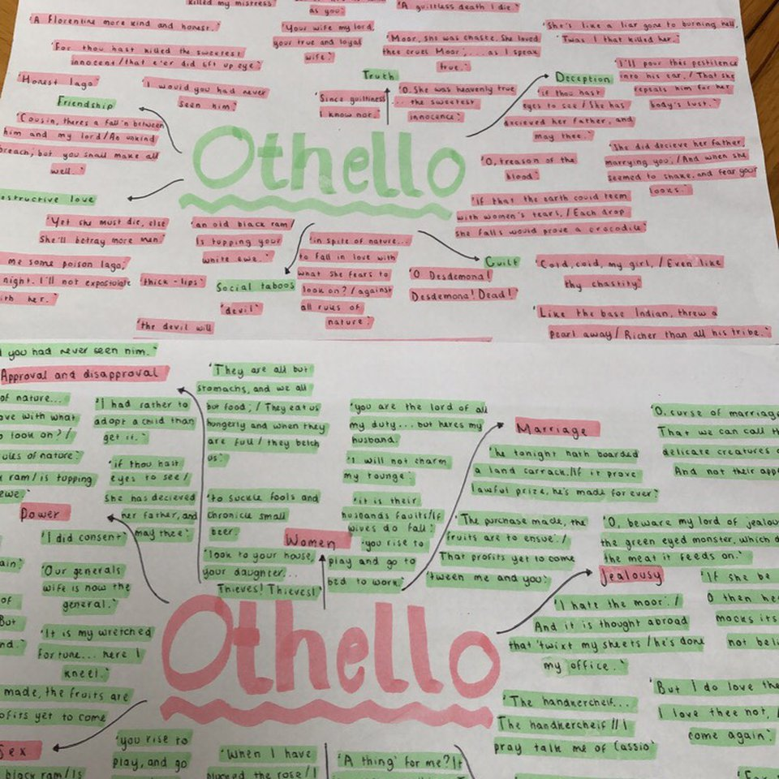
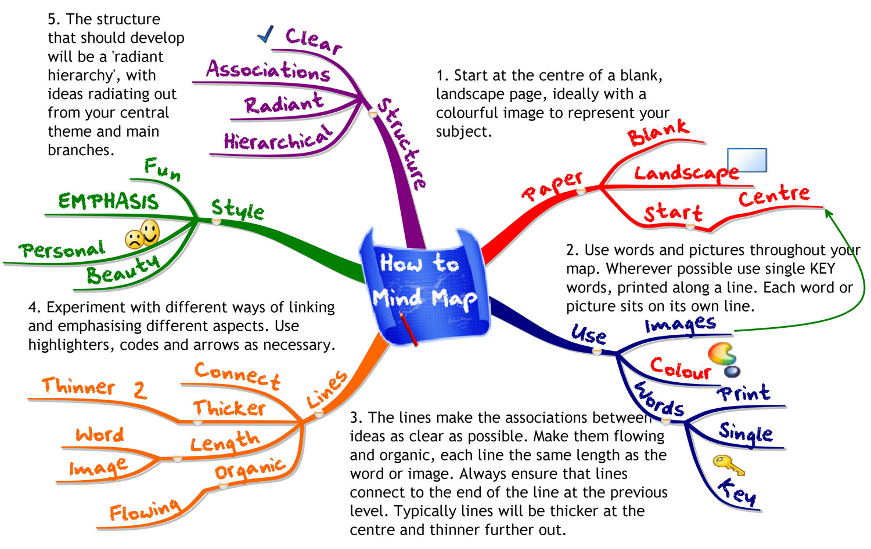
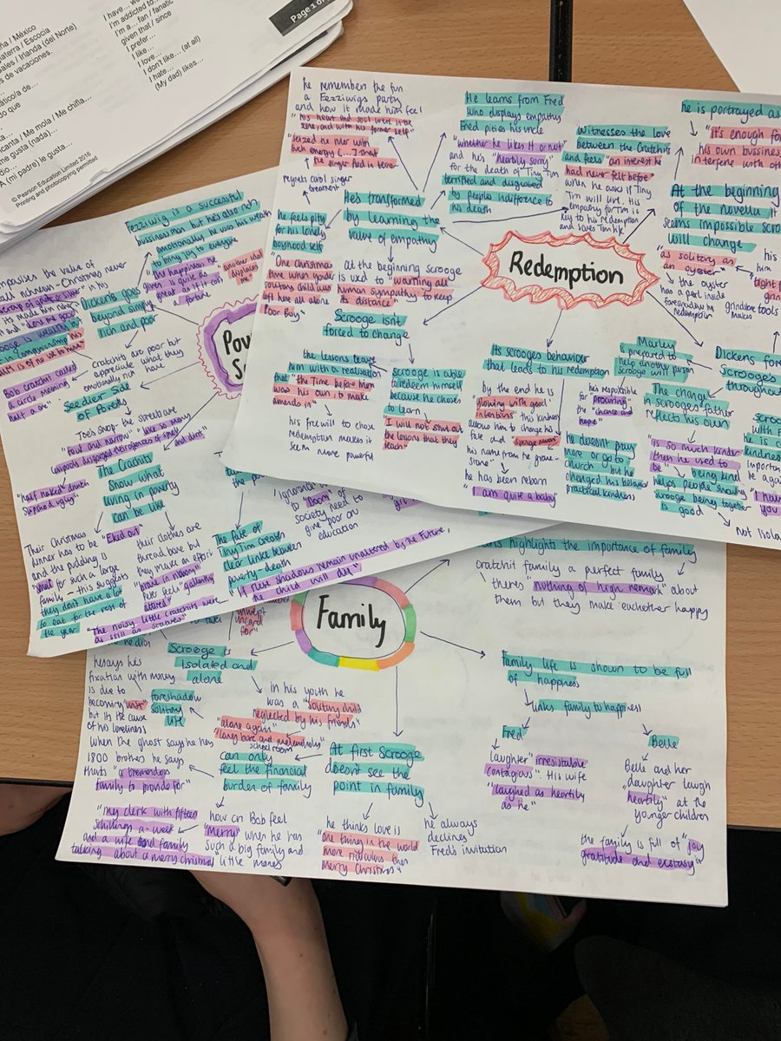
Mindmaps
Start from the centre of the page and work outwards adding key points.

Slide 28

flashcards
These are good for memorising lots of facts, definitions and descriptions.
They can also be used to make up your own questions and answers for a topic.

Slide 29
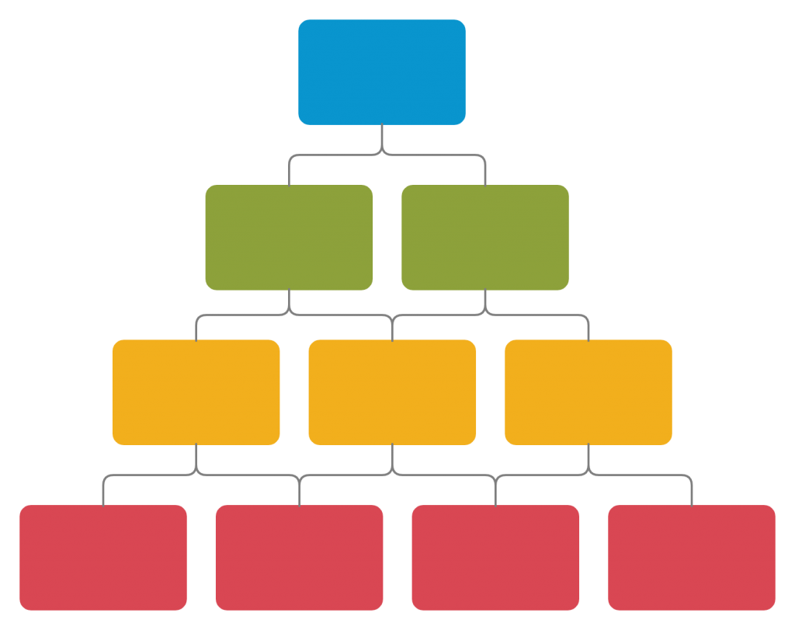
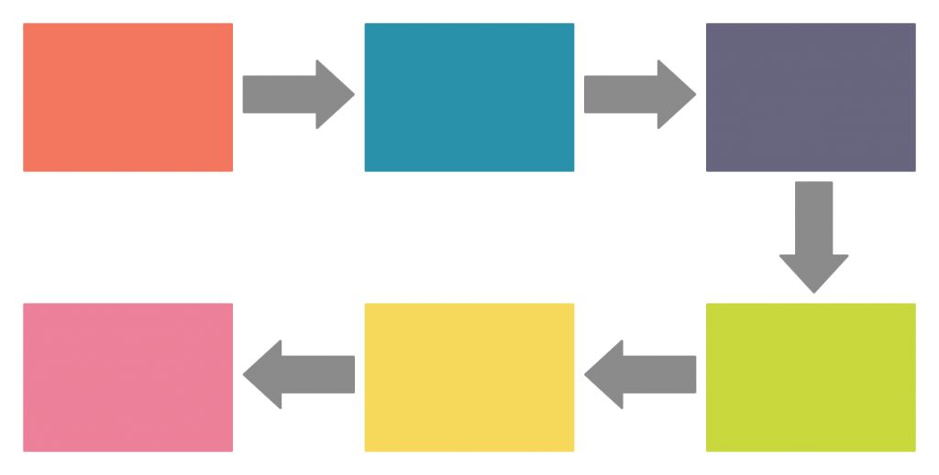
Graphic organiser
A way to summarise information from a topic.

Slide 30
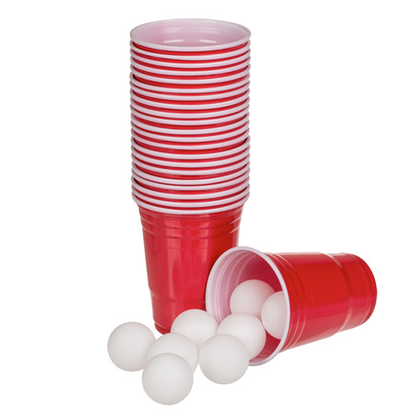

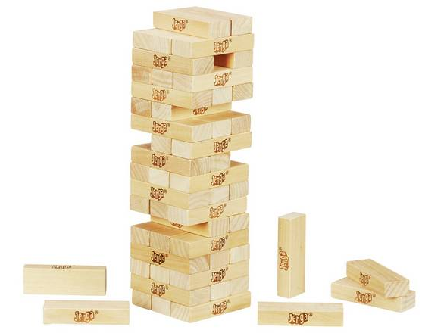
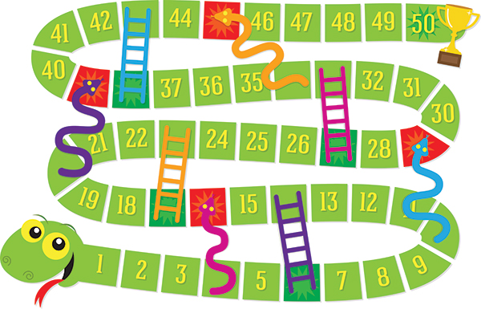
Revising with Friends
Games:
    Revision Pong
    Revision Grid
    Revision Jenga
    Revision Snakes & Ladders

Slide 31


ONLINE RESOURCES
BBC Bitesize Scotland – Higher Business Management
BrightRed Digital Zone

Slide 32
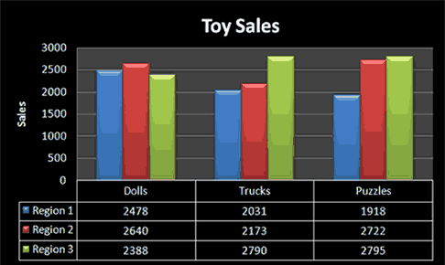

Flow charts/tables/graphs
Some types of information are easier to understand when you make a flowchart or table or graph.

Slide 33
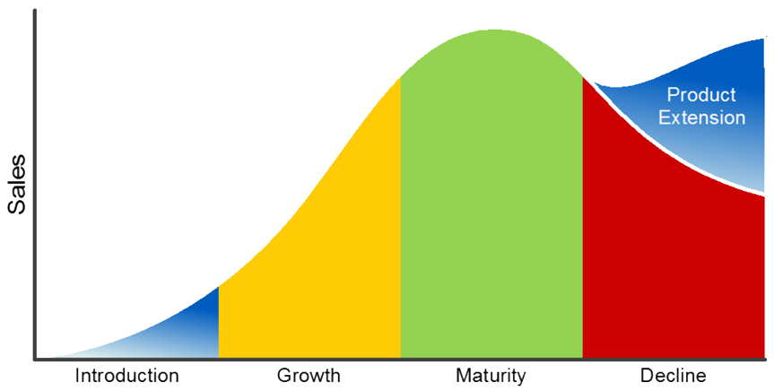
Labelled diagrams
Use a central image/picture and add information around it.

Slide 34
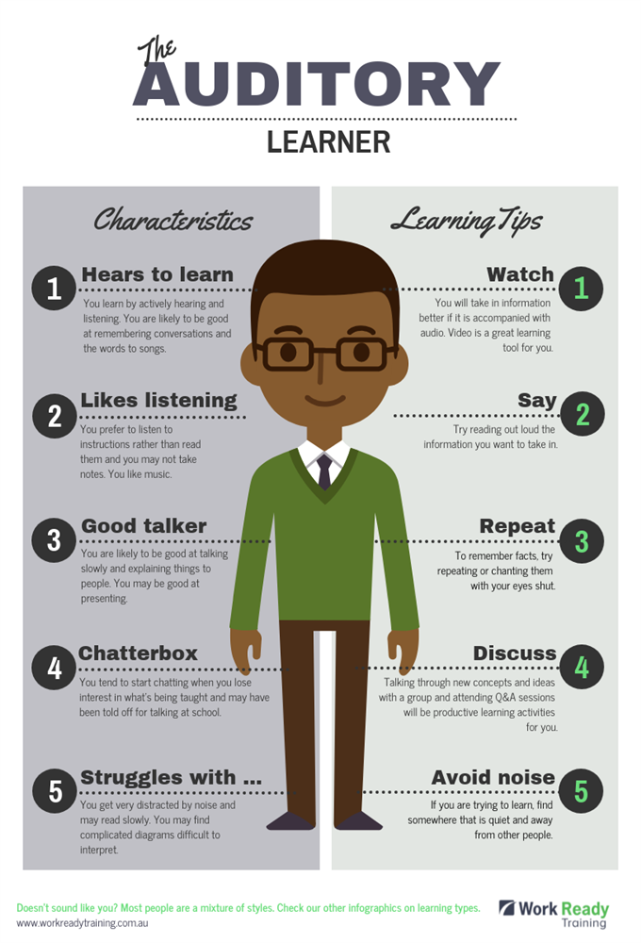
Auditory learning
These are memory techniques (mnemonics) which include:
RHYMES & SONGS
ACRONYMS
ACROSTICS

Slide 35
Rhymes & Songs
Example: Maths
Matrix multiplication, a common mnemonic uses the song "Oh, My Darling Clementine"
Row by column, row by column
Multiply them line by line
Add the products, form a matrix
Now you're doing it just fine!

Slide 36
ACRONYMs
PESTEC
POLITICAL
ECONOMIC
SOCIAL
TECHNOLOGICAL
ENVIRONMENTAL
COMPETITION

Slide 37

ACROSTIC
Example:
Chemistry – Reactivity Series
Potassium P Please
Sodium S Say
Magnesium M My
Zinc Z Zebra
Iron I Is
Copper C Cool

Slide 38

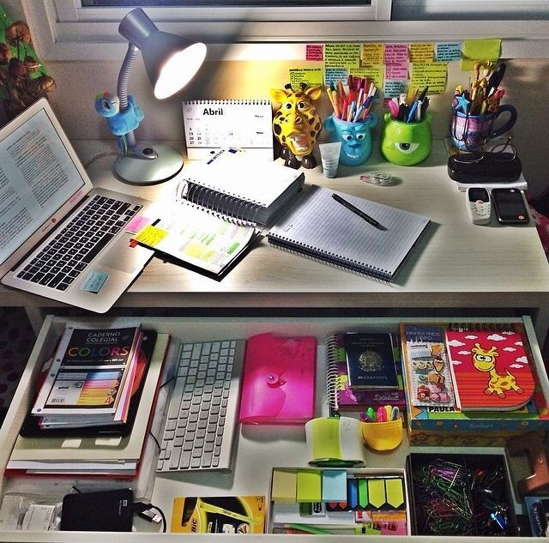
Study skills: Hints & tips
Make a timetable
Find a quiet work space
Work through past papers
Take regular breaks
Know what topics to work on
Do a little bit of work each day
Make a list and update regularly
Mark your work and fix mistakes
Ask for help when you need it

Slide 39



The importance of self-care

Slide 40
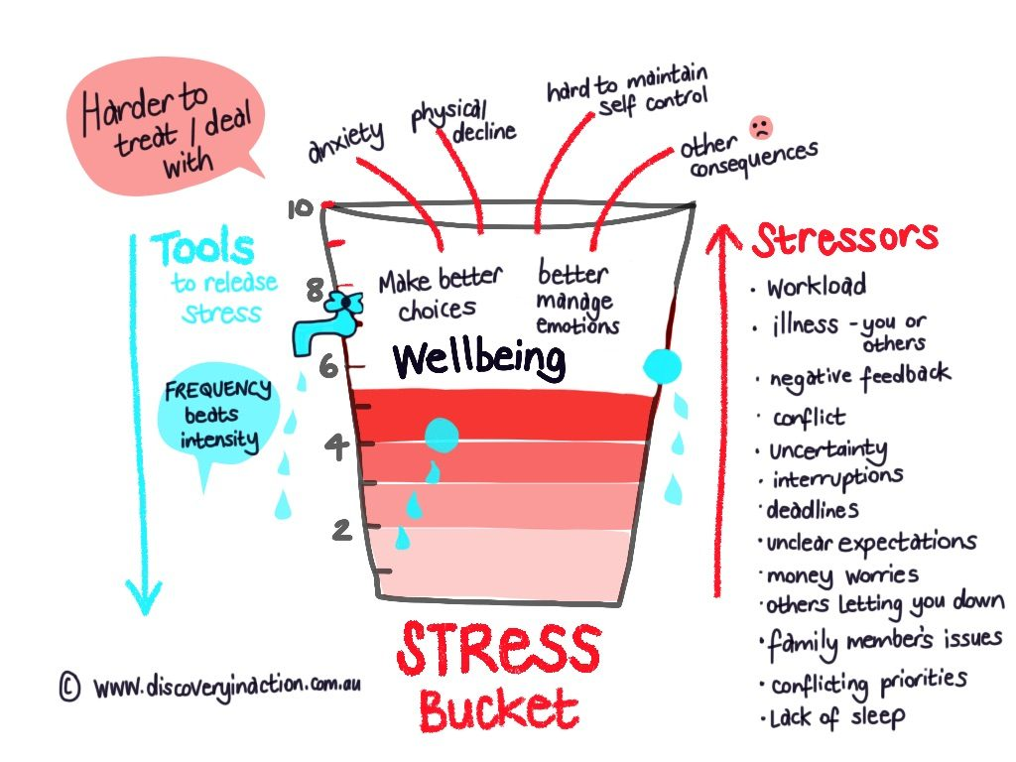

Slide 41
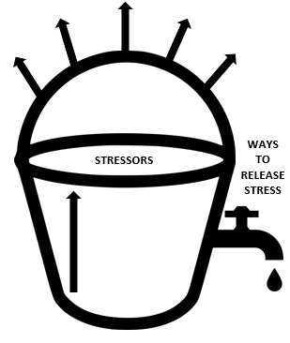
STRESS BUCKET TASK
CREATE YOUR OWN

Slide 42
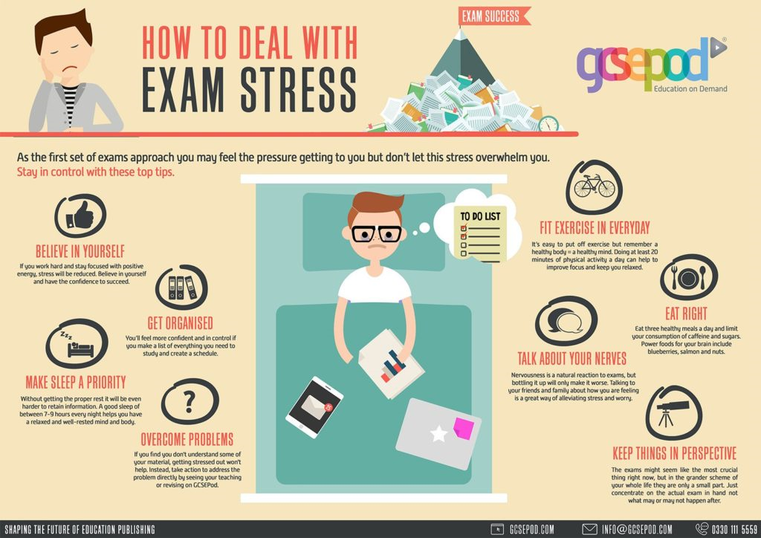

Slide 43
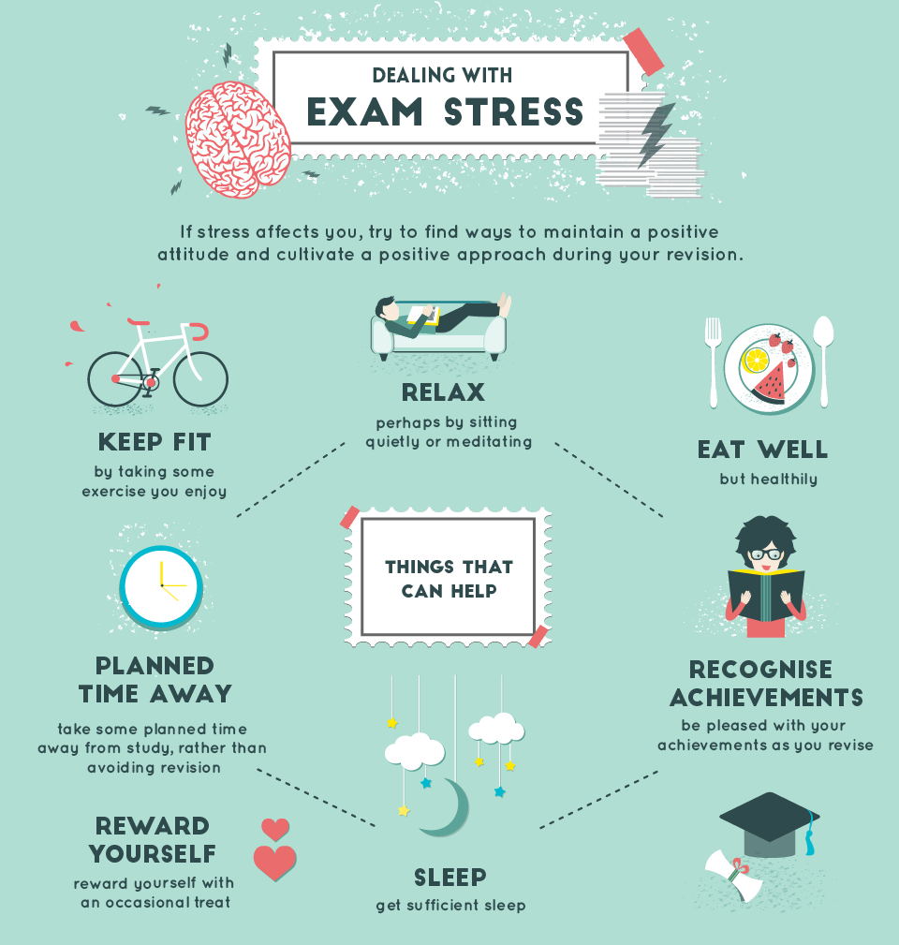

Slide 44

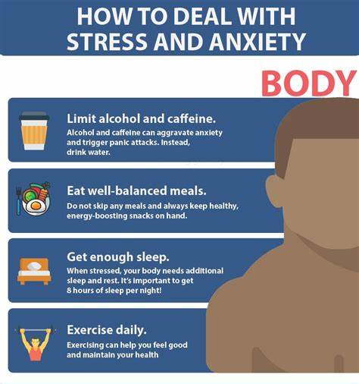


Slide 45


To conclude…

